Slide 1


CircuitOps and OpenROAD: Unleashing ML EDA for Research and Education
QuickStart: https://bit.ly/3SrE827 Please follow these instructions to prepare for your participation in the hands-on parts of today’s tutorial !
https://github.com/ASU-VDA-Lab/ASP-DAC24-Tutorial
Andrew B. Kahng, UCSD
Vidya A. Chhabria, ASU
Bing-Yue Wu, ASU
Notes:
Good afternoon and welcome to Tutorial Number Eight, CircuitOps and OpenROAD: Unleashing ML EDA for Research and Education. My name is Andrew Kahng from UCSD, and with me is Professor Vidya Chhabria from Arizona State University, and her Ph.D. student Bing-Yue Wu.
If you have not received or followed the instructions to prepare for your participation in the hands-on parts of today’s tutorial, please go to this bit.ly link. Bing-Yue will try to enable your Google Cloud access as quickly as possible.

Slide 2
Agenda
1. Introduction (1400-1415, Andrew)
2. Tutorial Section 1
OpenROAD Python APIs (1415-1440, Vidya)
Hands-on session: Demo on OpenROAD Python APIs and what it enables (1440-1525, Bing-Yue)
BREAK (1525-1545 minutes)
3. Tutorial Section 2
CircuitOps (1545-1605, Vidya)
Hands-on session: Demo on CircuitOps and what it enables (1605-1635, Bing-Yue)
4. Other ML EDA Infrastructure Efforts + Conclusion (1635-1650, Andrew)
5. Overflow Q&A (1650- , Vidya and Bing-Yue)
Notes:
Here is the agenda. We will have a 20-minute break after the first main section on OpenROAD Python APIs. After the break, the second main section will be cover CircuitOps. Then we will conclude by mentioning other efforts worldwide, and have Q&A. This room is available to continue beyond 5pm if there is interest.

Slide 3
1. INTRODUCTION
Notes:
Why do we have a tutorial on CircuitOps, OpenROAD, and ML EDA ?

Slide 4
1.1 The Problem
Notes:
It is because this lets us attack THE problem facing our industry, which is

Slide 5
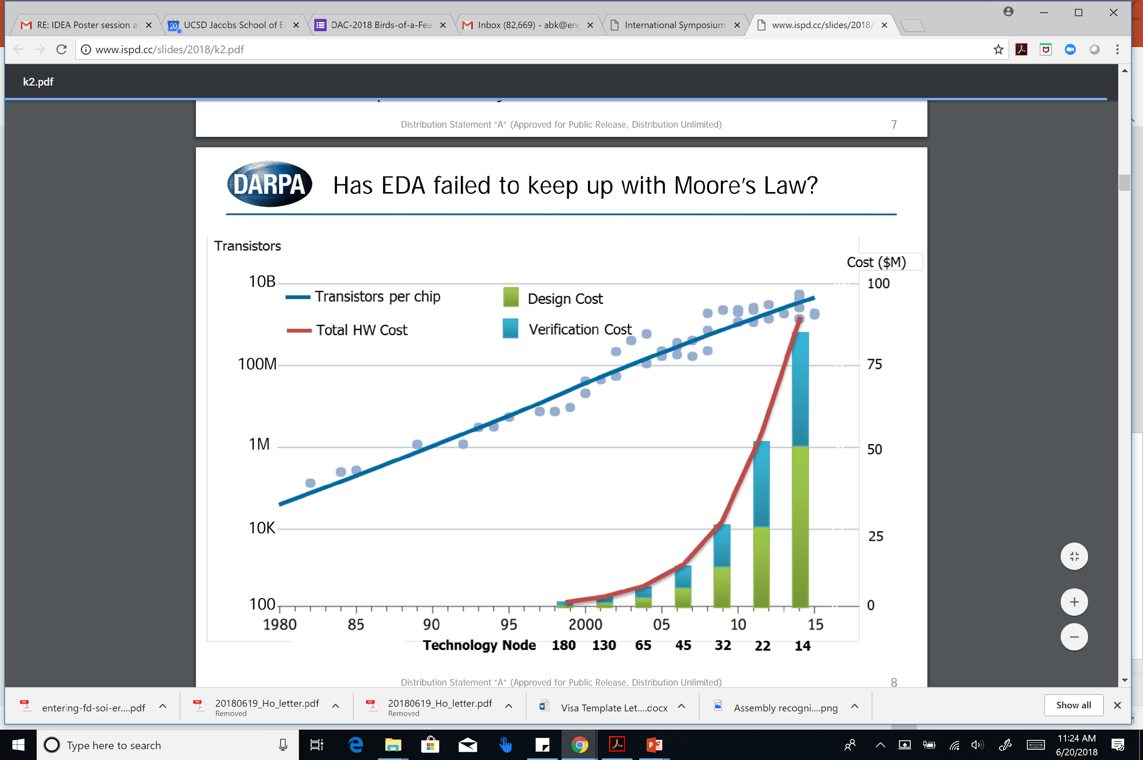
The Crisis of Hardware Design
ASIC design in advanced nodes: barriers of Cost, Expertise, Risk
Innovators can’t evaluate PPAC metrics of their design ideas
A. Olofsson, ISPD-2018
Notes:
the crisis of hardware design. This crisis is what motivated the OpenROAD project 6 years ago, and it motivates use of machine learning in EDA and IC design.
Today, taking ideas into silicon runs into BARRIERS of Cost, Expertise, and Risk.
[CLICK] In this picture, the red curve says that the cost of DESIGN is OUT OF CONTROL. So, innovators can’t tell how good their ideas are, in terms of hardware metrics like PPAC – Power, Performance, Area and Cost – because it is too difficult to take their ideas into silicon.

Slide 6
Design with Proprietary EDA: Need $$$, Experts
Very sophisticated tools with 1000’s of commands
Vendor focus: performance, power, area for bleeding-edge customers
20+ years of “hyperoptimization” in two main platforms (= closed silos)
Need large teams of expert users, many manual steps
Long project schedules: tool latencies, limited licenses, …
Significant project risks
Notes:
Today there are wonderful commercial EDA tools that can transform HDL code into tapeout GDS.
[CLICK] They have thousands of commands, so that bleeding-edge customers can squeeze the ULTIMATE performance, power and area density out of a foundry’s technology.
[CLICK] But these tools are difficult to master. You need expert users who perform many manual steps. Runtimes are long, licenses are costly, and the industry is a duopoly -- which works against openness and interoperability. These factors compound and bring more risk to chip design.

Slide 7
1.2 The OpenROAD Project
Notes:
Which brings us to OpenROAD.

Slide 8
OpenROAD: June 2018 – December 2023
“Foundations and Realization of Open, Accessible Design”
Funded by U.S. DARPA as part of the Electronics Resurgence Initiative (ERI). (UCSD = prime contractor)
Mission: Democratize IC Design, Boost HW & EDA Innovation
Revitalize EDA
Contract: Deliver an Open-Source, RTL-to-GDS EDA system
24-hour, no-human-in-loop, tapeout-clean layout in FinFET nodes
Since 2020, Precision Innovations, Inc has been the key industrial developer: R&D, support, outreach
Major support from Google (+ commercial engagements)
Notes:
OpenROAD was launched in June 2018 as part of the U.S. DARPA Electronics Resurgence Initiative.
[CLICK] The OpenROAD mission is to democratize IC design, and to boost both hardware and EDA innovation at scale.
The contract with the U.S. Government was to deliver a tool that produces RTL-to-tapeout-clean GDS, in commercial FinFET nodes, in 24 hours, with no human in the loop. Oh – and in permissive open source.
[CLICK] We put together a great team of universities plus Qualcomm and Arm.
[CLICK] Since 2020, a company called Precision Innovations, Inc has driven R&D and the support and outreach that the project also demands.
And we’re grateful for major support from Google and from several commercial engagements.

Slide 9
OpenROAD: RTL-to-GDS, No Humans, 24 Hours
FOCUS: Ease of use and runtime
Directly attack the crises of design and innovation
Schedule barrier: RTL-to-GDS in 24 hours
Expertise barrier: No-human-in-loop, tapeout GDS
Cost barrier: Open source (and, runs in 24 hours)
Unleash system innovation and design innovation
Enable tool customization to system, application needs
Notes:
Unlike commercial EDA, the focus of OpenROAD is on ease of use and runtime.
[CLICK] It helps solve the crisis of design AND the crisis of innovation by attacking those barriers of schedule, expertise and cost.
[CLICK] This unblocks system creation and design space exploration – with near zero overhead. It’s is also very customizable – for 3D chiplet flows, or to optimize security or resilience objectives.

Slide 10
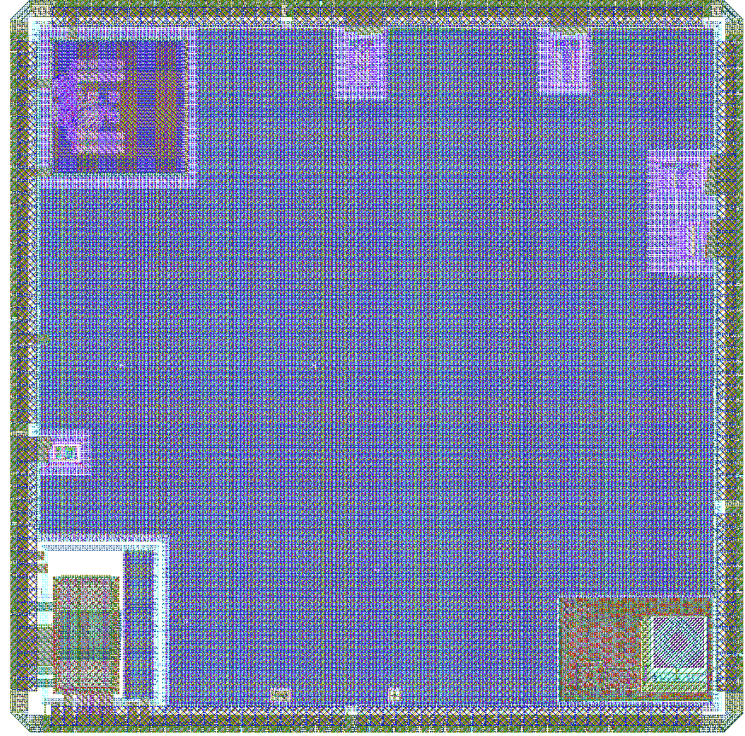
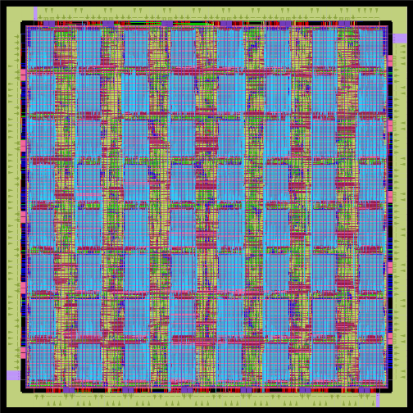
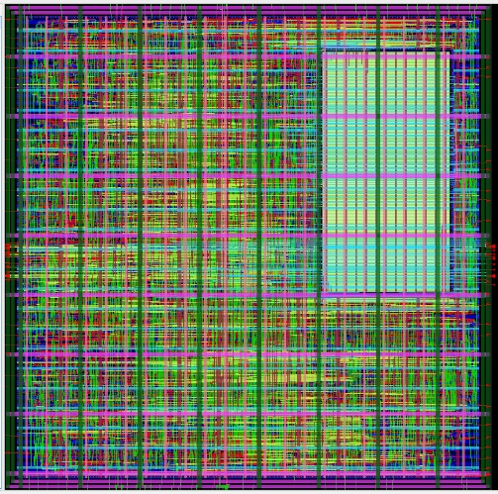
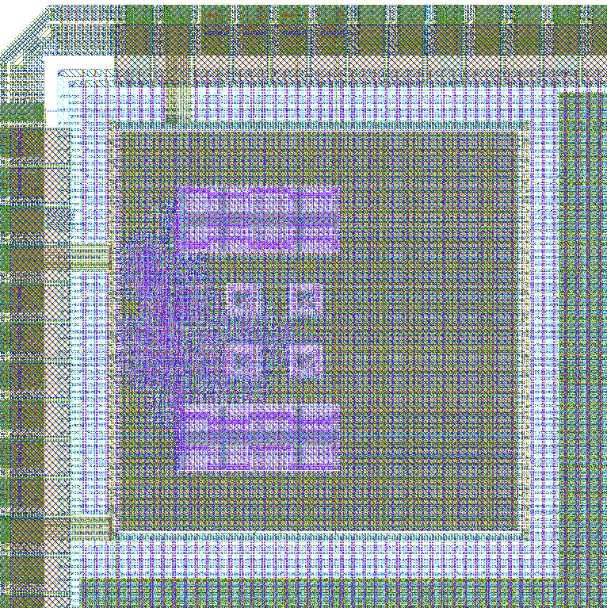
Usage in Advanced Nodes
GF55 AI platform
GF12LP AI tile
OpenTitan SoC
Army Research Labs
GF55, GF12LP
U. Michigan / FASoC GF12LP
Notes:
These examples are from a couple of years ago. On the left is a reprogrammable AI platform in GF 55 nanometers, and a reprogrammable AI computing tile in GF 12 nanometers, from the Army Research Lab -- using OpenROAD.
On the right is a University of Michigan GF12 that included this OpenTitan SoC with integrated temperature sensors.
All of the physical design and timing optimization was done with OpenROAD.
[[This work includes a GF55 (3.5mm x 3.5mm, 64 8kB SRAMs, ~800k instances) reprogrammable AI platform and a GF12 (245 um x 245 um, 8kB SRAMs, ~30k instances) reprogrammable AI computing tile.]]

Slide 11
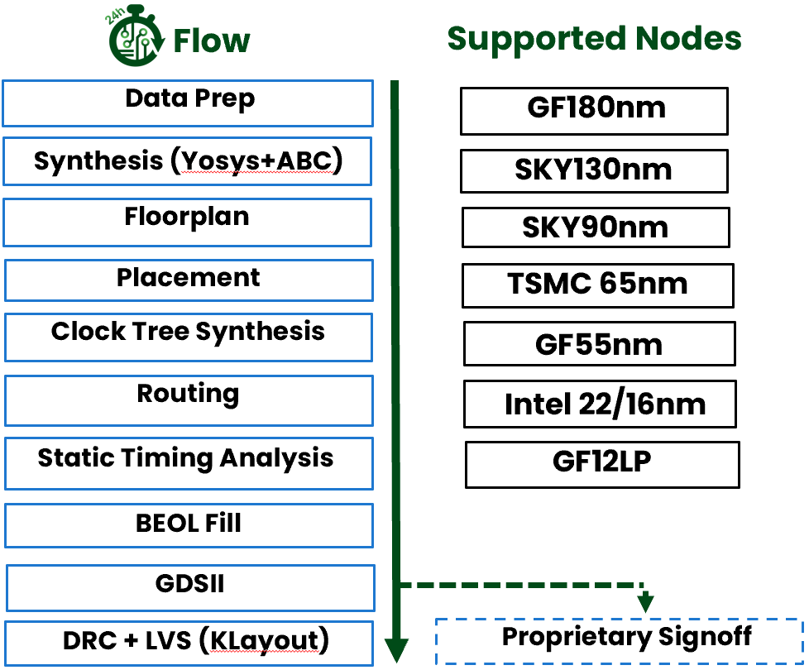
Today: Momentum, “Going Viral”
Functionality: 600+ tapeouts at 180-12nm
Community: OpenROAD app has >19K commits from 88 contributors
Education and Workforce: from high school to graduate level, extension
Researchers
Small R&D teams, startups
Notes:
OpenROAD is a very unique working partnership [CLICK] of academic researchers and EDA veterans.
[CLICK] There’s been over 600 tapeouts in commercial foundry 180nm to 12nm. With a growing community of contributors and supporters. So OpenROAD has become “viral”.
[CLICK] OpenROAD supports education and outreach on many levels – Carnegie Mellon University recently blogged about their classroom use of OpenROAD, and IBM OpenPower launched a faculty development program in India this past summer.
[CLICK] OpenROAD also supports researchers -- in both EDA and hardware design. And it helping many small R&D teams – at startups and at big companies – get their ideas to layout.

Slide 12

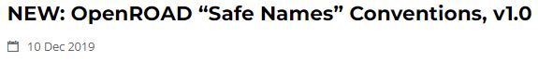
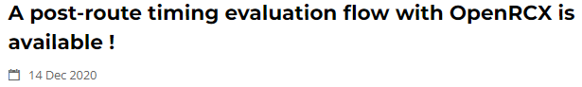
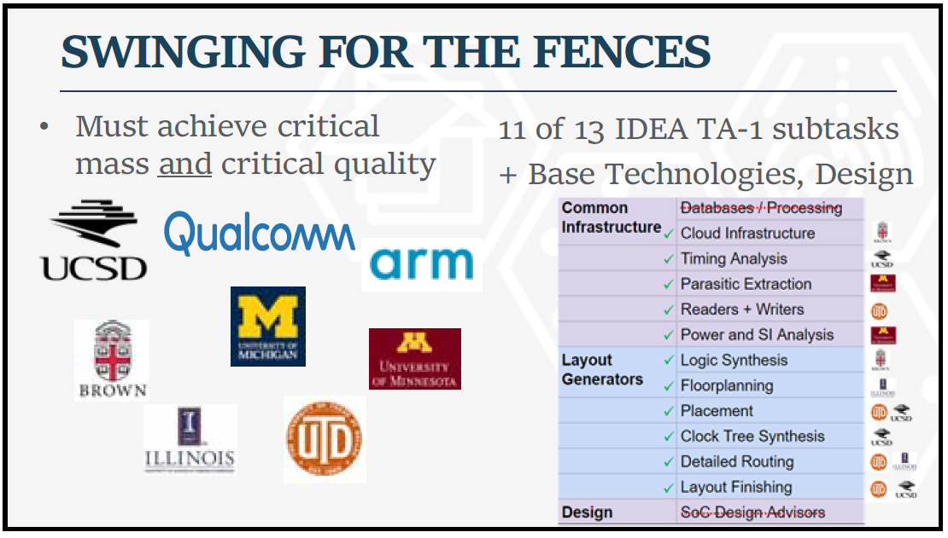
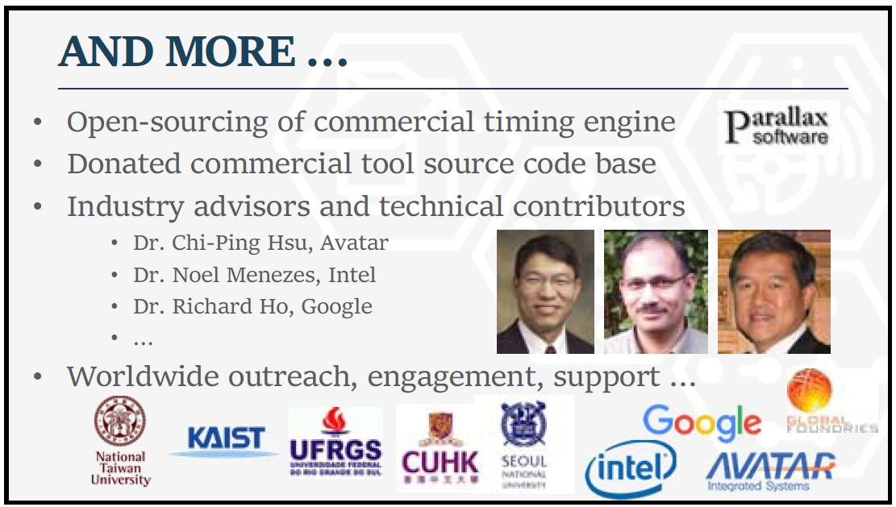
“Not Research As Usual”
An academic research project, delivering tapeout-clean layout generation for commercial FinFET nodes in permissive open source, per contract with the U.S. Government
🡪 expectations, names, “signoff”, …
“Not Research As Usual”
First ERI Summit, July 2018
Notes:
To get to this point, there was a lot of “not research as usual”.
Many challenges come from being an academic project that by contract must deliver tapeout-clean layout generation in commercial FinFET nodes, via permissive open source.
These early project announcements hint at some issues that had to be navigated: For example, our Tcl command names and timing reports needed to stay clear of industry copyrights.
[CLICK] And we pre-emptively addressed many issues as well. This “And More” slide is from the OpenROAD presentation at the first ERI Summit in 2018. When we submitted the proposal, we had commitments from Parallax Software to open-source its timer, and donations of two commercial tools’ source code bases, and permission to use an EDA company’s established Tcl naming conventions. So: “not research as usual”.

Slide 13
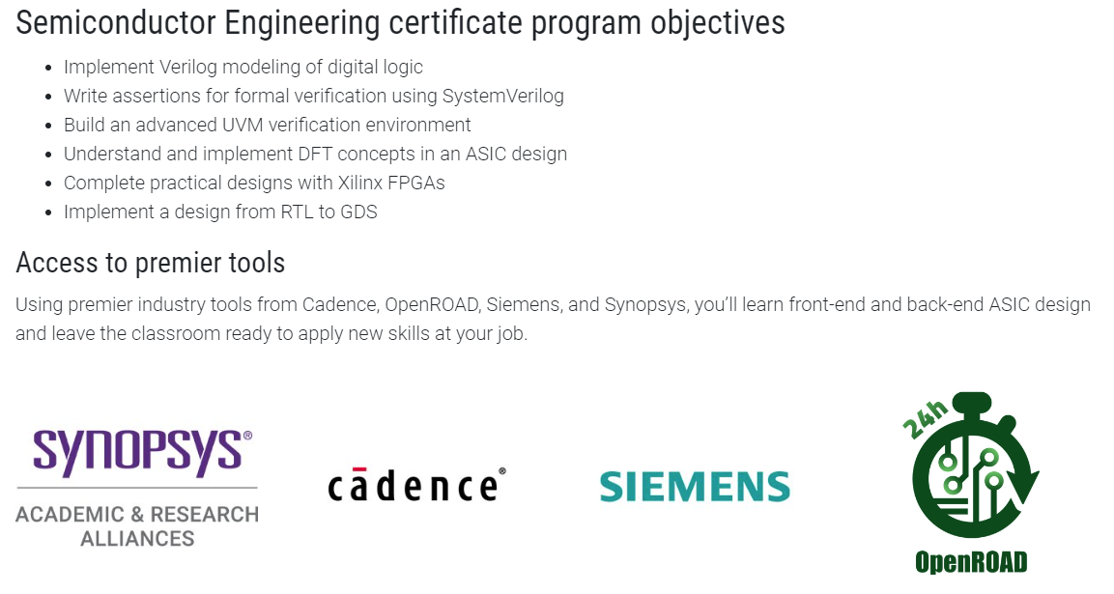
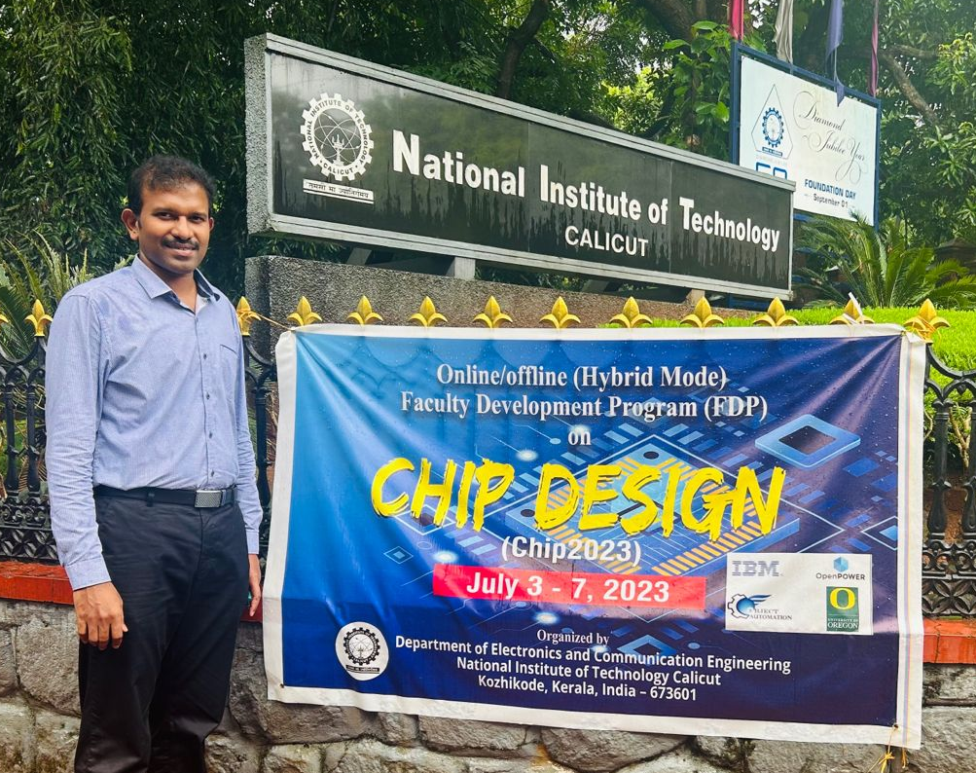
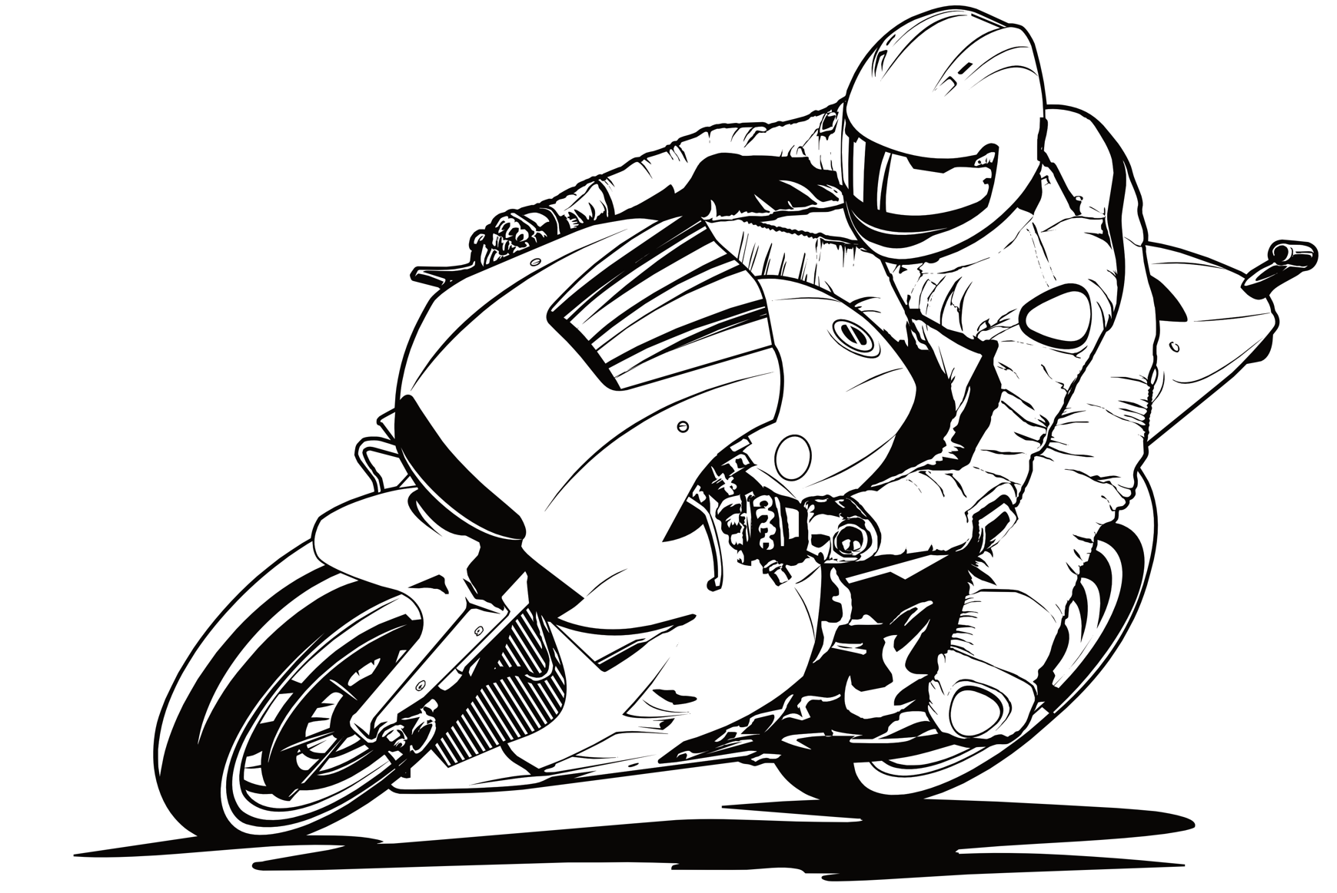

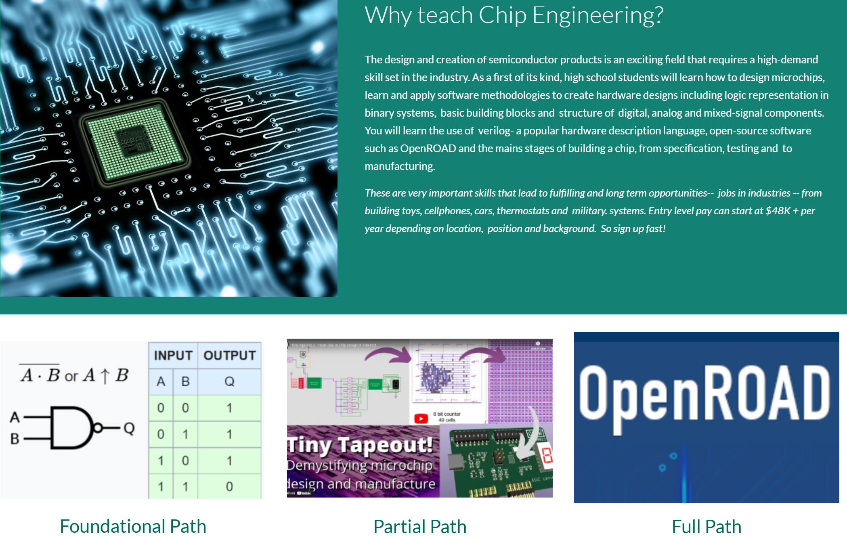
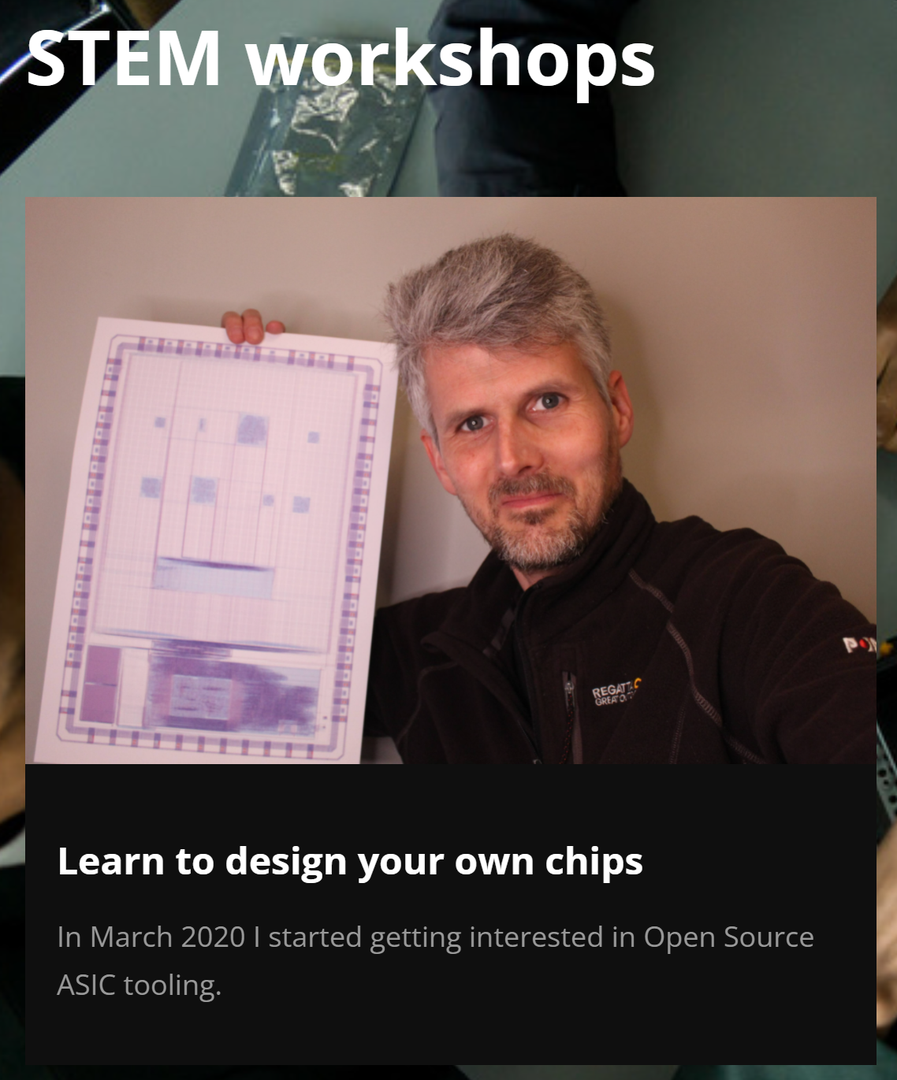
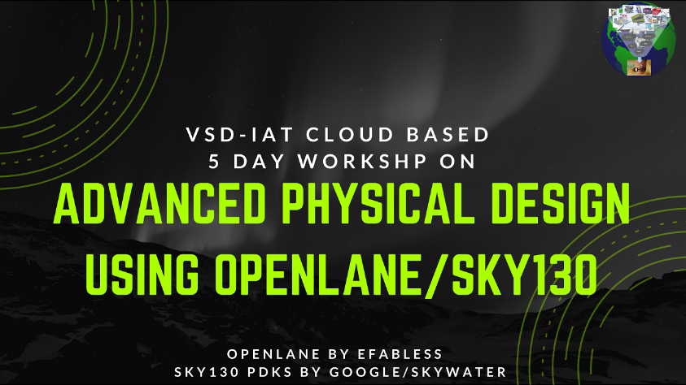
Supporting the Next Generation
Help with curriculum development, sharing, mentoring !
before
Notes:
An important role of OpenROAD is helping to attract and train our next generation. OpenROAD is part of IC design Workforce Development, from middle-school exposure to re-skilling older workers. It can open the funnel to exposure and hands-on learning earlier, without NDAs and license servers. It is better at what we call an “on-ramp”: training wheels for future designers.
[CLICK] These are pictures from UC Santa Cruz Extension, education and training programs in India, and a Google Site that was created by two high school teachers in California, all with OpenROAD support.
VIT Lab. Object Automation.
IBM OpenPOWER. MicroWatt

Slide 14

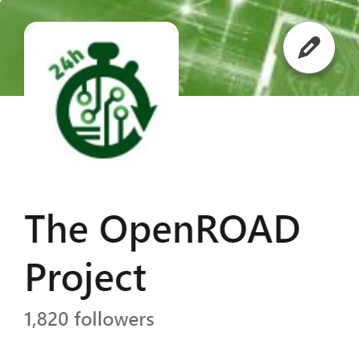

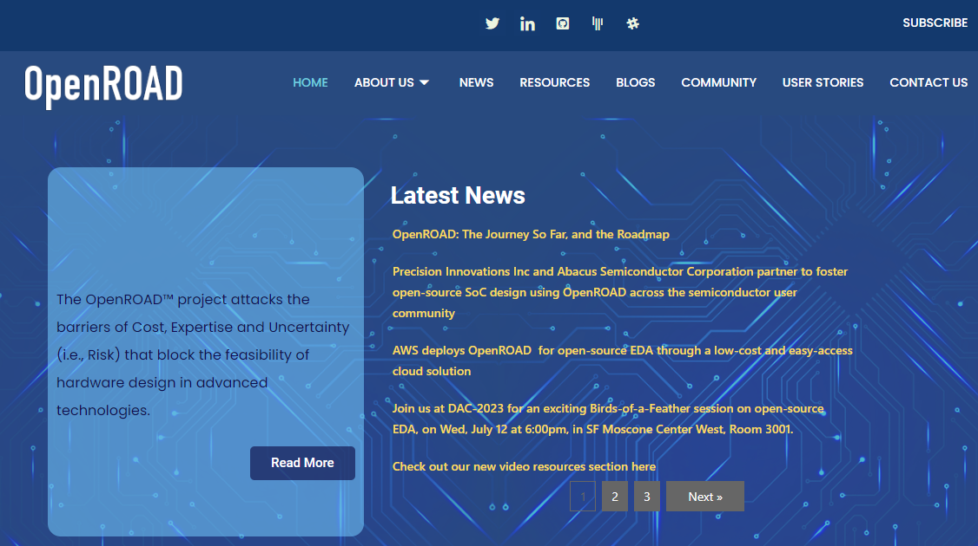

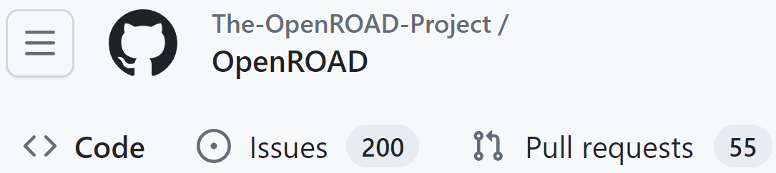
Supporting a Community
Join the community !
Novice to Expert
Applications: Trust, 3DIC, AI/ML, …
Notes:
Also, our community continues to grow across a wide spectrum of users and application interests. There are many channels -- please join in !

Slide 15
OpenROAD Availability https://openroad.readthedocs.io/en/latest/main/README.html
The Project on GitHub
https://github.com/The-OpenROAD-Project
The Flow
Automated full flow, built using tool components that are created for automation
https://github.com/The-OpenROAD-Project/OpenROAD-flow-scripts
The Top-level Application
An integrated EDA tool focused on full automation
https://github.com/The-OpenROAD-Project/OpenROAD
More!
Documentation: https://openroad.readthedocs.io/en/latest/main/README.html
Slack: https://skywater-pdk.slack.com/archives/C0161A4A59V
OpenTapeout video: https://www.youtube.com/watch?v=wvPZREaP7E0&t=2652s
See also: https://theopenroadproject.org/videos/
Notes:
And just in case: here are pointers to repositories on GitHub,
[CLICK] a nicely automated flow, and
[CLICK] the integrated EDA tool.
[CLICK] There’s Docs and Slack discussions -- and some videos that introduce and teach about the tool online as well.

Slide 16
1.3 Why Machine Learning
Notes:
Today’s tutorial is about how OpenROAD plus NVIDIA’s CircuitOps enable Machine Learning in EDA. So: Why Machine Learning?

Slide 17
Machine Learning
[Simon et al.] Learning is any process by which a system improves performance from experience
[Mitchell et al.] Machine learning is the study of algorithms <P,T,E> that
Improve performance P at task T
Using training data (experience) E
Computer
(ML)
Data
Output
Program
Parameter training
(supervised, unsupervised, etc.) to improve Program
Notes:
What is machine learning?
[click] Herbert Simon defined it as a learning process, by which a system can improve its performance from experience.
[click] Tom Mitchell said machine learning is the study of algorithms with three elements <P,T,E>. The computer can improve its performance P at task T by utilizing training data, or experience E.
[click] This figure shows a basic diagram of a computer program. For a given task, we load the computer with data and program, then the computer itself generates the outputs. [click] With machine learning, the program will improve by itself by various ways, such as supervised or unsupervised learning.

Slide 18
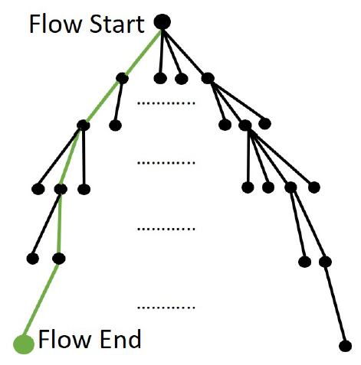
Challenge: IC Design “Lives in a Box”
Start
Start to End: expensive!
O(year) for product
O(weeks) for SP&R and Opt
Goal: best possible End
Constraint: stay in “Box”
{compute}
X {licenses}
X {people}
X {weeks}
End
Huge space of trajectories: architecture, enablement, IPs, tools, manual fix, …
Notes:
Here’s a cartoon of the design optimization problem --- **which you can also think of as a SEARCH problem** --- that makes a REALLY IMPORTANT POINT.
From the FLOW START, there are many steps and decision points (like IO placement or density screens) on the way to a complete OUTCOME, the routed DEF plus signoff reports, which is a FLOW END leaf.
Start to End is expensive – from weeks to months. We want the best possible END but there’s a huge space of trajectories, and
[CLICK] the point is: DESIGN OPTIMIZATION must stay in a BOX of servers, licenses, people, and weeks of schedule.

Slide 19
ML for EDA and IC Design: What
Predict
Will RouteOpt finish with clean signoff, <1000 DRVs by tomorrow night?
Classify
Out of these 50 floorplans + budgets, which 3 should go into trial SP&R?
Estimate
How many hold buffers will tool eventually add into this post-CTS layout?
Guide / advise
What P&R tool setup/script will obtain the best QOR within next 36 hours?
More broadly: answer any question that is difficult for humans
Google Brain, 2020: “super-human macro placement” on arXiv
Overarching: “intelligent flow”, “automated super-human expertise”
More directly: regressions and image classifications (LSF, litho)
Notes:
WHAT Machine Learning in EDA and IC design does spans
[CLICK] Predicting (will the router finish?), and Classifying (is this floorplan and budgeting solution viable?),
[CLICK] Estimating, and Guiding – for example, what flavor of my SP&R or leakage recovery script should I run for this particular block?
[CLICK] BROADLY: ML in EDA tries to answer questions that are difficult for human experts.
As we all know, Google Brain in their April 2020 arXiv paper claimed super-human macro placement through use of Deep Reinforcement Learning! [Since then, many Google talks along with their Nature paper published last year reinforce this claim.]
MORE IMMEDIATELY: there’s still a lot of regression and image classification going on – putting jobs onto the right-sized servers, or looking for litho hotspots.

Slide 20
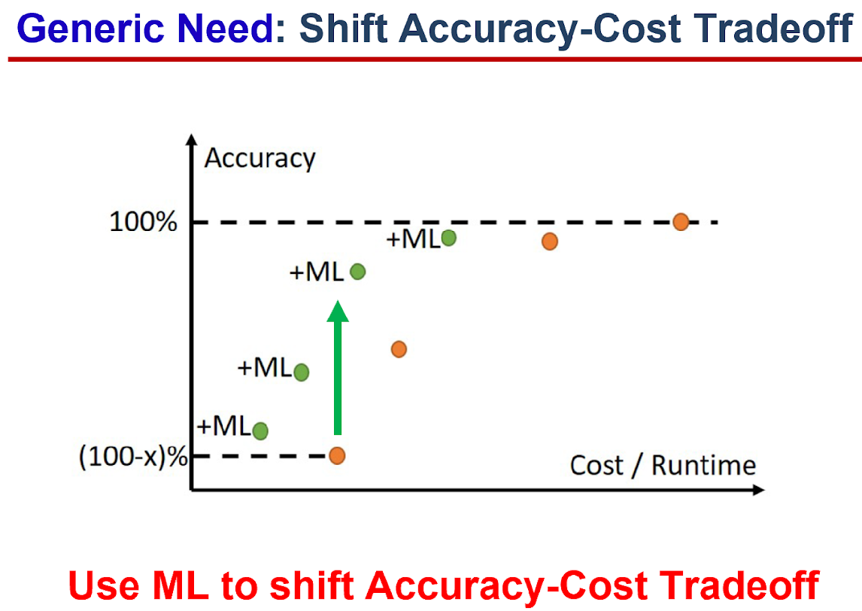
ML for EDA and IC Design: Why
A. You need models to have predictions
B. You need predictions to leverage in exploration
C. What you can’t predict, you guardband
D. What you don’t explore, you leave on the table
E. C and D are bad for product quality and schedule
We are in an Era of Optimization
Look for ML to win quality, schedule, cost
E.g., reduce analysis runtime, miscorrelation
🡪 We hope that ML will bring Scaling
Notes:
And WHY “Machine Learning for CAD” --
[CLICK] You need models to have predictions
[CLICK] You need predictions that you can leverage in exploration
[CLICK] What you can’t predict, you guardband
[CLICK] What you don’t explore, you leave on the table
[CLICK] And: those last two are really bad news.
[CLICK] With slowdown of process scaling, we are in an Era of Optimization, where we look for ML to win us Quality, Schedule and Cost. [CLICK] For example, less miscorrelation between creation tools and signoff tools improves design schedule and quality.
[CLICK] So in a nutshell, we hope ML brings us Scaling.
[[Cost of correlation vs. cost of miscorrelation ..]]

Slide 21
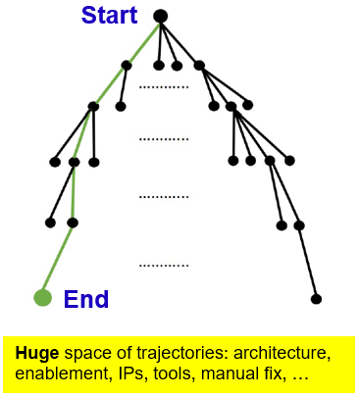
4 Aspects of ML for EDA and IC Design
1. Mechanization and Automation
Create super-human robot engineers
2. Orchestration of Search and Optimization
Optimize the use of N robot engineers
3. Pruning via Predictors, Models
Predict design-specific tool outcomes
Prune “doomed runs”
4. From Reinforcement Learning to Intelligence
Target: “MLDA”, “self-driving tools and flows”, “superhuman”
Notes:
These four aspects of ML in EDA are becoming real very fast.
There’s mechanization. We want to take time-consuming, error-prone, trial-and-error design tasks, such as floorplanning or timing closure, and build superhuman, automated capability. AutoTuning is a form of mechanization that helps take human experts out of critical paths to finding good design solutions or tool/flow settings.
[CLICK] There’s orchestration. If we have automated design capability, how do we optimally orchestrate N copies of it? Again: see Autotuning and evolutionary methods as a jumping-off point.
[CLICK] There’s modeling and prediction, where almost all efforts have been focused. Of course, you need data to learn from. This is where stuff like METRICS – which some of you have seen from my group for over 20 years – comes in.
Remember: Predictions let us PRUNE unpromising design trajectories, and do better WITHIN our RESOURCE LIMITS.
[CLICK] And the field is moving fast on this last aspect: from Reinforcement Learning toward Intelligence and, ultimately, self-driving ML-enabled EDA.
Along the way, we will attack a number of GENERIC NEEDS.

Slide 22
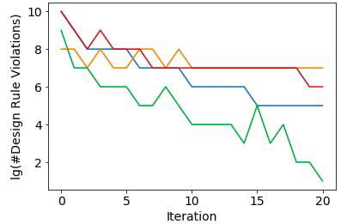
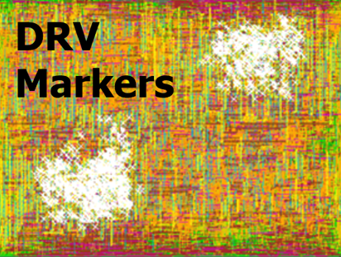
Generic Need: Prediction of Doomed Runs
Figure from link link link
Example: progression of DRC violations in commercial router
Strategy: track and predict key metrics as time series
Goal 1: Terminate “doomed router runs” early
Goal 2: Modify placement to avoid doomed router runs
Notes:
One GENERIC NEED IS: PREDICT WHETHER A TOOL RUN IS GOING TO FAIL.
For example, with the detailed router, you don’t want to wait a week for it to finish with 90 thousand violations.
In [CLICK] this picture, router iteration count is on the X-AXIS. LOG of the number of DRVs is on the Y-AXIS.
[CLICK] So it’s a TIME SERIES. And our goal is to LEARN to kill the red and orange runs early, but let the green run finish.
[CLICK] And then, we want to learn how to modify the placement to avoid doomed router runs.
There are a few other generic ML EDA needs, but in the interest of time you can see the slides and speaker notes offline.

Slide 23
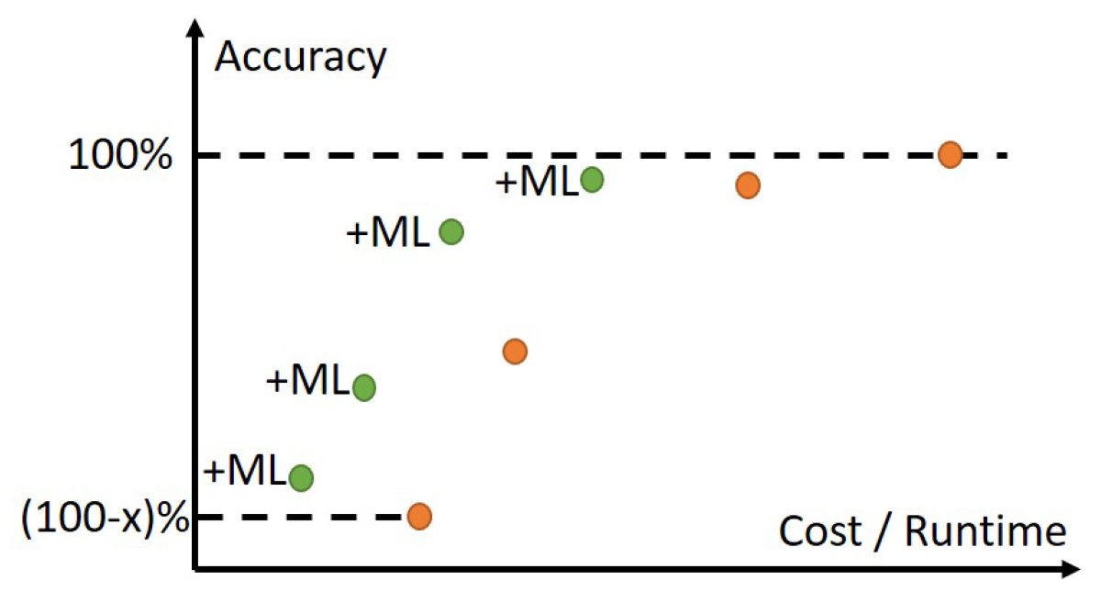
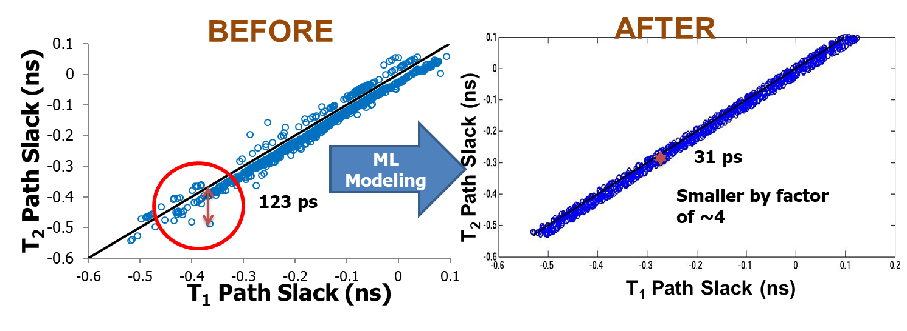
Generic Need: Shift Accuracy-Cost Tradeoff
DATE14 link SLIP15 link
Use ML to shift the Accuracy-Cost Tradeoff
Notes:
Another GENERIC NEED is in the ANALYSIS realm, where the ORANGE dots show the traditional COST (on the X-axis) versus ACCURACY (on the Y-axis) tradeoff curve, for instance, going from 3D field solvers at the top right to piecewise analytic models to first-order estimates, etc. We’re always picking and choosing which orange points to use during IC design.
Machine Learning lets us create GREEN tradeoff points: essentially, getting off the ORANGE curve and gaining accuracy for FREE.
That’s the GREEN [CLICK] arrow here. This ALSO improves modeling and prediction so we have fewer loops and less margins in the design process.
[CLICK] This DATE-14 work showed how you could essentially take reports from a cheap timer, and turn them into reports from an expensive timer. The learning model could shrink miscorrelation by a factor of 4.
The value propositions here are obvious and there’s been progress – SI, PBA-GBA, driving leakage and sizing optimization, reducing corners -- but there’s DVD and LVF and exhaustive PBA ahead, plus production deployments have been tough.
[Why I think this is basically an “inevitable no-brainer”: it’s (well-understood) physics.]

Slide 24
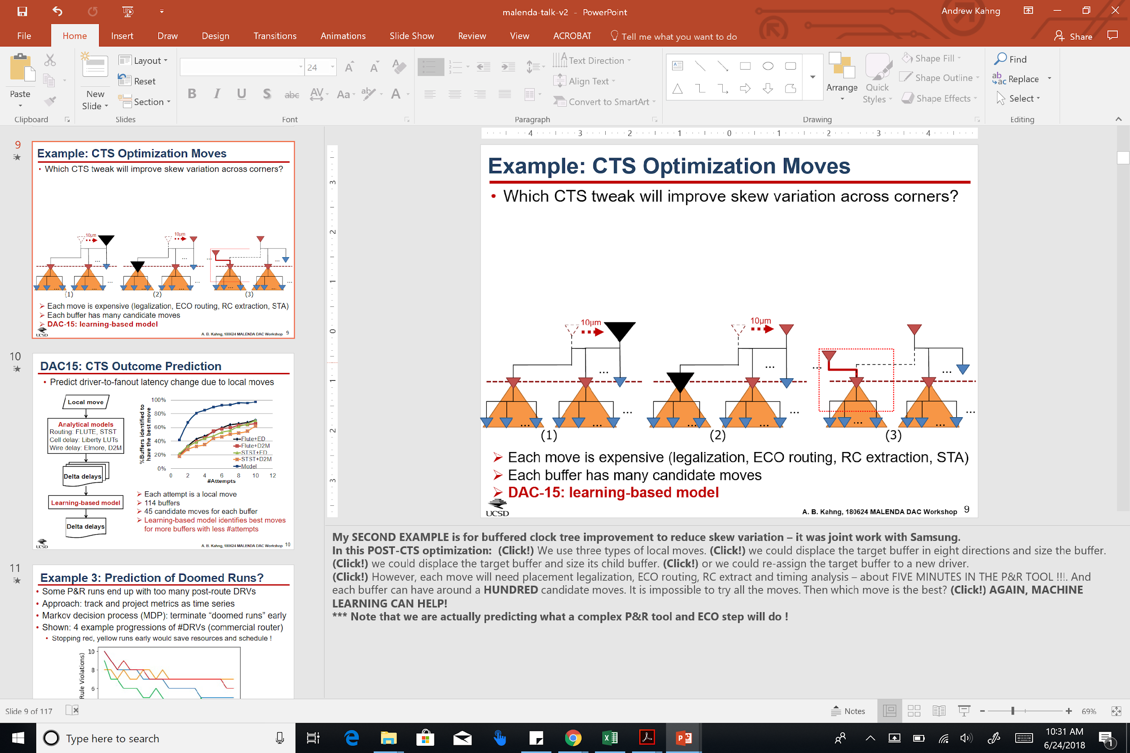
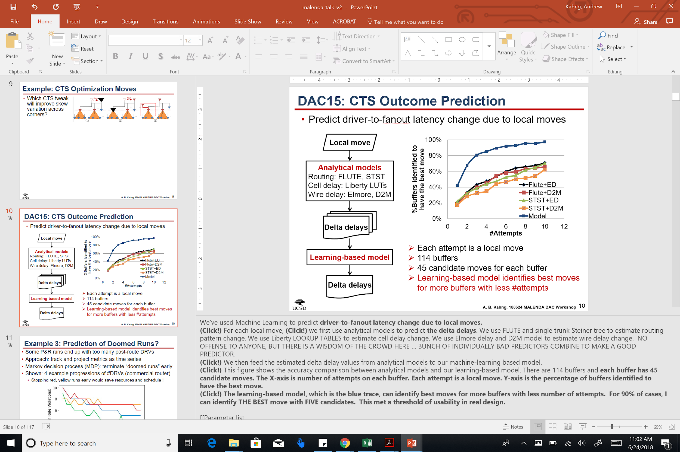
Generic Need: Model-Guided Optimization
DAC15 link
Which CTS tweak will improve skew variation across corners?
24
Notes:
A third GENERIC NEED is model-guided OPTIMIZATION. This DAC15 work asked which buffered clock tree surgical tweak – move, or size, or recluster – will best reduce skew variation across corners
Each tweak takes time to evaluate through legalization, ECO route, extraction, STA – and there are MANY possible tweaks.
[CLICK] A learning-based model was based on estimated delta delay values from simple analytical models such as Elmore delay or FLUTE Steiner trees.
In the CHART, the X-axis is number of move “guesses” or “attempts”. The Y-axis is the percentage of trials where a buffer’s ABSOLUTE BEST MOVE is identified within those number of guesses.
The learning-based method in the blue trace identifies best moves for more buffers with fewer attempts – and, THE BEST move within FIVE guesses, for 90% of the cases. This was predicting what a black-box P&R tool and ECO step will do.
And there’s actually a high-level question of who is empowered to fill this need – EDA suppliers or EDA users.
[[Recurring themes in ABKGroup works: agnostic w.r.t. ML techniques; use multiple bad models to build good models (every dog has its day?); HSM/HHSM ~ ensemble modeling often used; …]] [[+ domain experience …]]

Slide 25
1.4 Why CircuitOps + OpenROAD ?

Slide 26
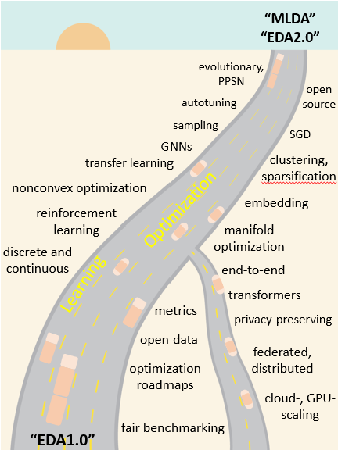
Too Many Challenges, Too Little Time
Shared infrastructure for ML EDA is important and timely!
Unblocks new ML modeling and EDA optimization opportunities
Enables us to accelerate progress even as the field and industry become mature
ISPD22 keynote
Notes:
ML EDA has a rich future. This cartoon from two years ago proposed how we might advance over the coming years – as we improve learning and optimization, where some items are further along the road than others. BUT: The main message was that we really have too many challenges, and too little time.
So, shared and open infrastructure is urgently needed, because it unblocks and speeds up progress .[CLICK] It lets us accelerate even when our field and the industry become more mature and consolidated.

Slide 27
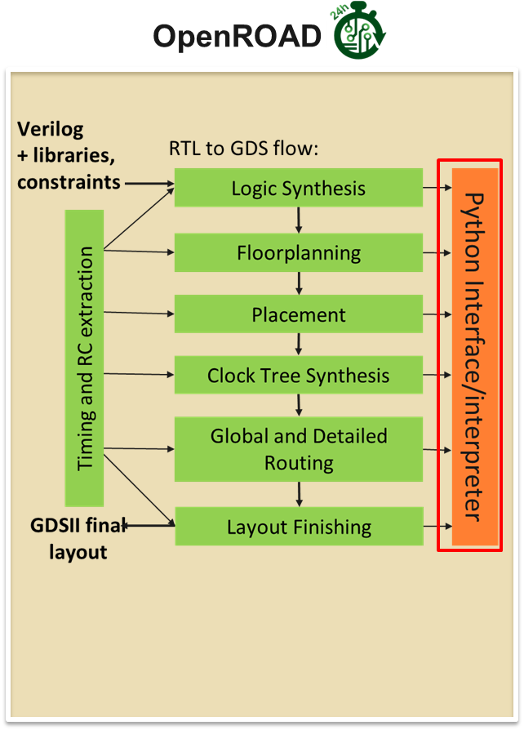
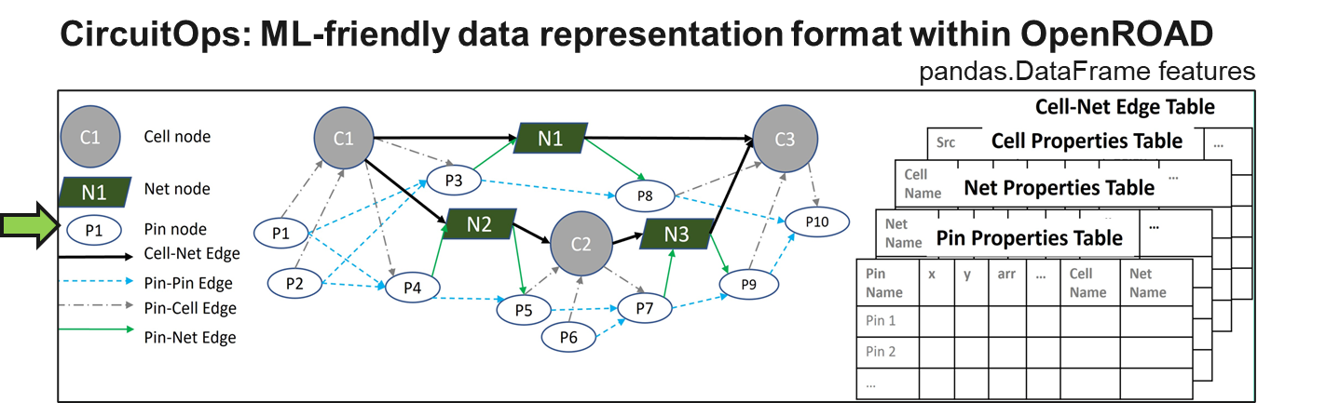
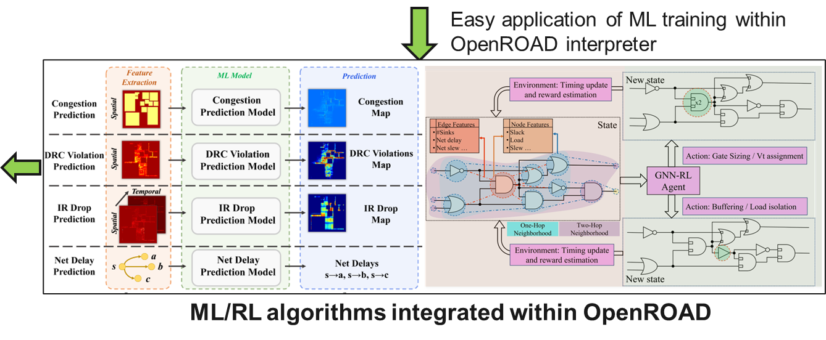
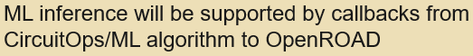
OpenROAD as an ML for Chip Design Playground https://github.com/NVlabs/CircuitOps
Notes:
Machine Learning for EDA – including GenAI in many forms – is a very hot and high-value research area. But amazingly, it has no infrastructure for research!
Here, OpenROAD is providing a new playground for EDA researchers, with three key pieces of infrastructure.
[CLICK] First, Python APIs in OpenROAD wrap the underlying C++ APIs of its EDA engines, which gives you faster data generation compared to using commercial tools’ TCL interfaces.
[CLICK] Second, we need open, ML-ready Data Formats. NVIDIA’s CircuitOps leverages OpenROAD to model chip data as labeled property graphs, and pandas data frames to store graph properties as features. (NVIDIA’s paper on CircuitOps was just presented at ICCAD a little under two weeks ago.) This streamlines integration of ML algorithms into EDA infrastructure.
[CLICK] Third, additional Python APIs in OpenROAD enable results of ML inference to be integrated back into the database, giving a feedback path from ML algorithms back into the EDA platform.
And ultimately this unleashes the innovation that discovers new ML-powered chip design methods.
So with this as a motivation for today’s tutorial, let me now turn things over to Vidya.

Slide 28
2. Tutorial Section 1
OpenROAD Python APIs

Slide 29
2.1 ML EDA infrastructure: Why and What
Notes:
Thanks you Prof. Kahng. To continue exactly from there I am going to start by motivating this tutorial at a lower level of detail with an example.

Slide 30
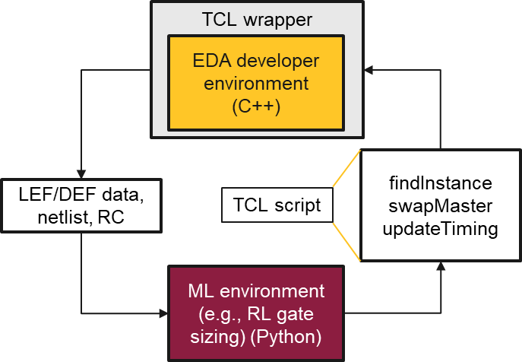
Motivation
Challenges with existing ML EDA tool development:
Slow: File I/O reads and writes for data exchange between EDA and ML application
Reinvention of the wheel: Python-based EDA tool development
Requires expert EDA users: ML experts need to understand EDA tool TCL usage
Des. | #cells | #nets | Runtime (s)
Des. | #cells | #nets | Python APIs | Tcl w/ file IO
aes | 30,202 | 17,812 | 12.6 | 31.5
bp_be | 141,468 | 58,464 | 26.4 | 103.6
bp_fe | 96,150 | 36,388 | 17.5 | 62.9
Notes:
There are three primary motivations for the infrastructure we are demoing today or the reason why we are having this tutorial .
Today, there is almost no infrastructure for ML-EDA and there is a lot of reinvention of the wheel.
If ML frameworks and EDA tools have to communicate with each other today, they have to do so through slow TCL interfaces, file IO, or there is reinvention of the wheel where new EDA tools have to be developed in Python.
To understand this motivation better lets take a look at an example. Let us say we are developing an ML-based iterative gate sizer, where the ML agent, decides the size of a few gates in the netlist at a timebased on certain timing-related features. Well, then what we have to do today, is we read the unsized netlist into an existing EDA tool through TCL interfaces with all those other files, we then generate the features we need for the ML model using the EDA tool’s timer, then we writeout this information into a file. Because we cannot run prediction of the ML model in a TCL interface. We have an ML file for the inference, we read the data from the file..Writeout the updates sizes of the gates and then put the updated netlist back into the EDA tool and repeat and its impossible to run ML and EDA tools iteratively like this.
One solution is to develop our own EDA tools in python basically in the gate sizing example we develop our own timer in Python but that comes back to a correlation issue, and a reproducibility issue.
While I only spoke about the example of an iterative gate sizer, the same can be applied to say an iterative timing drive placer which relies on ML estimates for its timing, or an IR-drop drive places which relies on an ML model for its IR drop values.

Slide 31
Components of ML EDA Infrastructure
Python APIs
Integration with EDA tool database
Enables data generation, feature extraction, and label annotation
ML- friendly data formats
Standard ML-friendly data representation formats
Supportive and lowers barriers for non experts
ML EDA algorithms
Callbacks with EDA tools via Python APIs from ML world
Automatic node and edge transformations from node to database updates
Notes:
In terms of libraries and ML EDA software infrastructure, basically setting aside data, PDKs, etc. What I see is three main components.
The first Python APIs wrapped around EDA tools to make it easy to both generate feature and annotate ML based inference resutls back into the EDA tool database.
The second ML-friendly data representations, and the
third, ML-EDA algorithms that leverage those APIs to to complete this feedback path of applying ML inference resutls back into the EDA tools.

Slide 32
Components of ML EDA Infrastructure
CircuitNet, GitHub
Notes:
You have seen a version of this slide earlier in the introduction as well. But I want to bring it back in context of this tutorial.
In this tutorial, we will demo an infrastructure that includes Python APIs around OpenROAD EDA tools. We will demo NVIDIA’s CircuitOps as a data representatoin for generative AI applications particularly netlist optimization. We will also show example ML-EDA algorithms that leverage the APIs and data representation formats.

Slide 33
Today’s Tutorial
Tutorial Section 1:
OpenROAD Python APIs and example enabled ML-EDA algorithms
Hand-on session 1
Tutorial Section 2:
CircuitOps data format and its interaction with OpenROAD Python APIs and example enabled ML-EDA algorithms
Hands-on session 2

Slide 34
2. 2 Examples of OpenROAD Python APIs

Slide 35
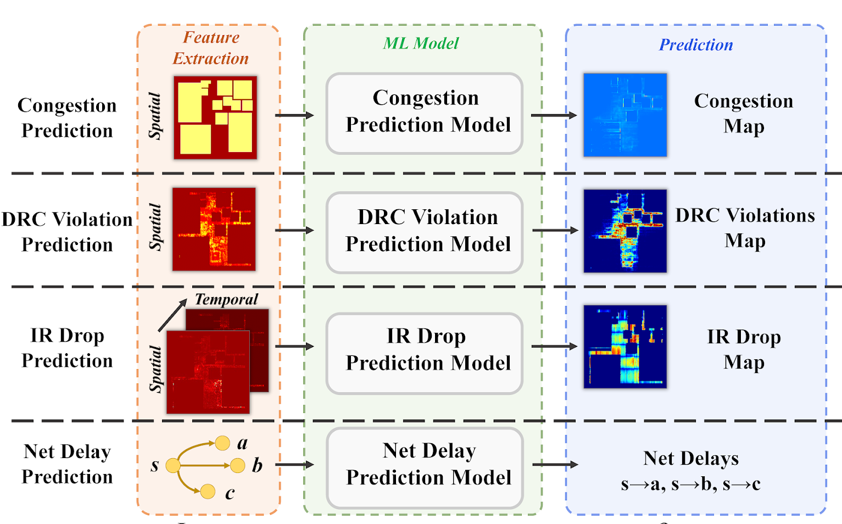
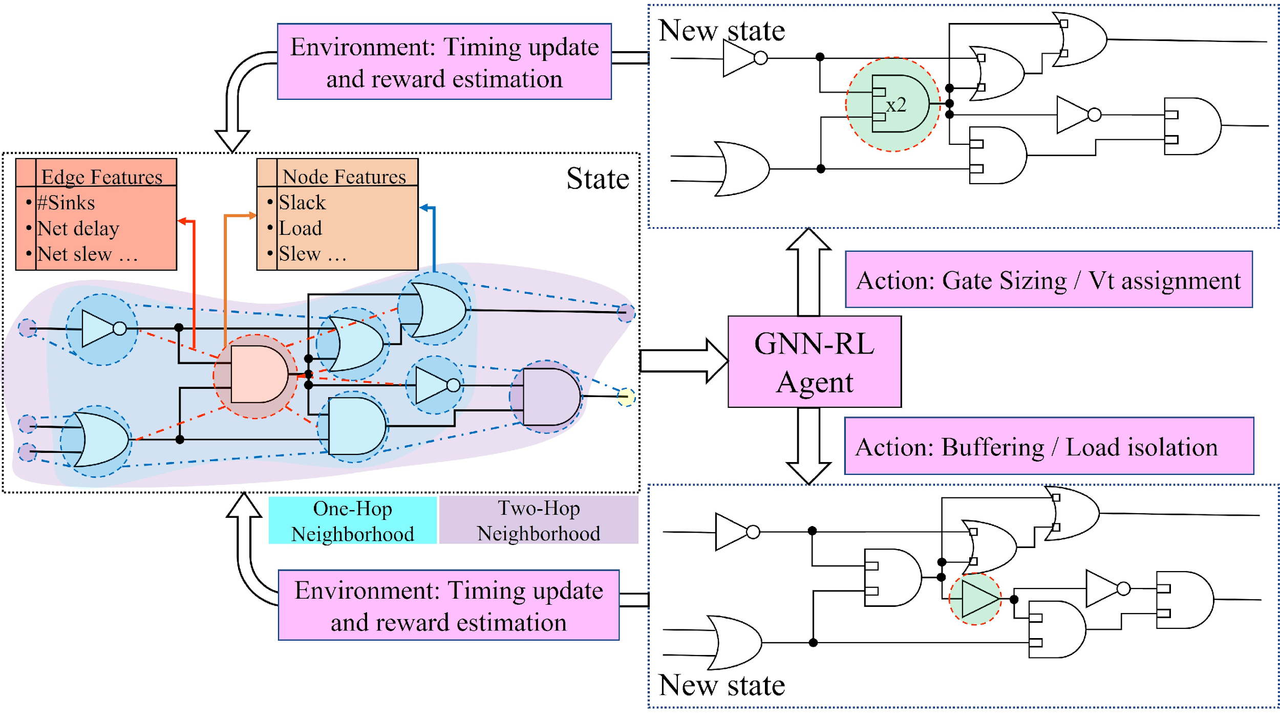
What ML EDA algorithms exist today?
GNNs, RL-based training, and CNNs
Data formats used: Graphs and images
Examples of graph-based and RL algorithms for EDA
Examples of image-based ML algorithms for EDA
RL-Sizer, BufFormer, NVIDIA 2022
Gate sizing using RL, UMN 2023
CircuitNet, GitHub
Notes:
To understand what APIs to develop we need a sense of understanding of what standard ML-EDA applications have had widespread adoption. We can put these into two categories, image-based and graph-based. Ofcourse the way the models are trained can be RL or perhaps a regular supervised learning way.
The left side is showing examples of netlist optimization using RL and GNNs and the right are showing a variety of image-based ML-EDA applications.
So the reason its important to understand these ML-EDA algorithms, its because we need to develop APIs that can support these application. Understand which features need to be queried what labels need to be annotated etc to aunderstnd what we need to enable.
So for these examples shown on the screen we need APIs that will enable image and graph creationgs from EDA tool database.

Slide 36
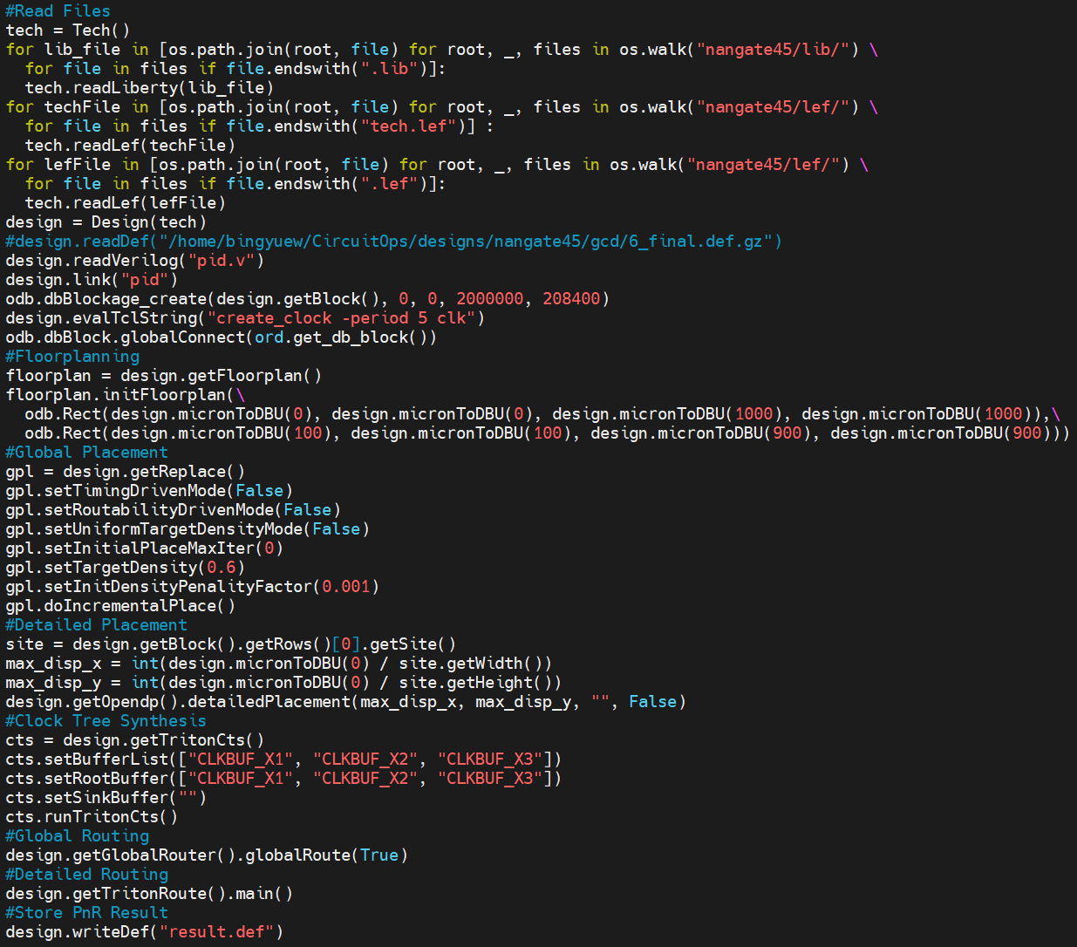
Examples of OpenROAD Python APIs
Top-level APIs to support core OpenROAD tasks
File read
Floorplan
Placement
CTS
Routing
Notes:
So coming to the specific Python APIs OpenROAD has support on. It has has top-level APIs support where in a python shell we can run any of the what I classify as top-level APIs to perhaps to place and route, to set variables. So the right image shows the EDA tool flrow in python. Starting from reading lef/def all the way to routing and writing out def/netlist.
Bing-Yue will go over an example flow as well in the demo.

Slide 37
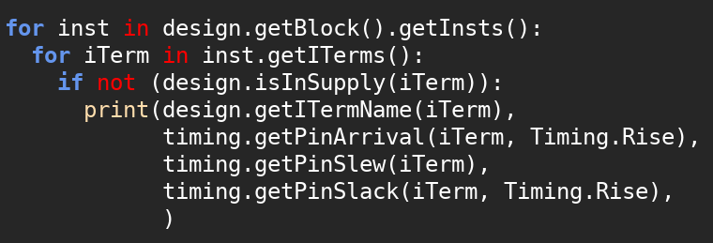
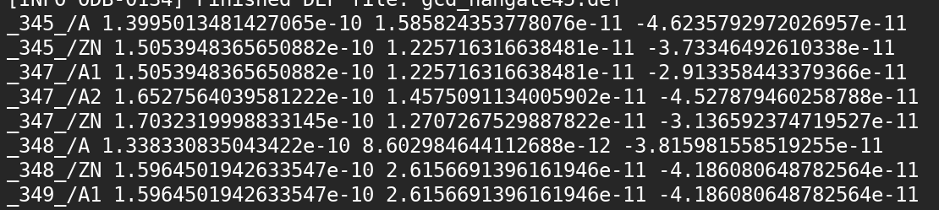
Examples of OpenROAD Python APIs
Example of DB Python APIs:
Get db instance
Get db pin (ITerm)
Get db pin arrival
Get db pin slew
Get db pin slack
Set instance location
Change cell size
Object attributes
Timing property lookup
db Pin
Arrival
Slew
Slack
Notes:
In addition, to those top-level APIs we have several DB APIs. Not only APIs that can query the DB for information but that can annotate the features back into the DB. So the picture here shows some APIs that are iterating through al instance in the design, iterating through the pins of every instance, and printing out the name, arrival time, slew and slack.
Two important things to note: All in Python. The return objects are all float. You can easily dump them into a numpy array, a torch array, pandas dataframe what ever your faortiy python data structure is.
In addition to querying the pins, you can also change properties of the netlist. Change the location of instance size, change cell type, etc. Here there are only few examples.
Bing-Yue will show you more on how to use these APIs in the hand-on session.

Slide 38
2. 3 What do these APIs enable?
Notes:
So now that we have these APIs what are the things that become easier? So in this tutorial, we will show you two use cases of the APIs. The first usecase we will talk about in this is IR drop prediction. The second is an RL-based gate-level sizer.

Slide 39
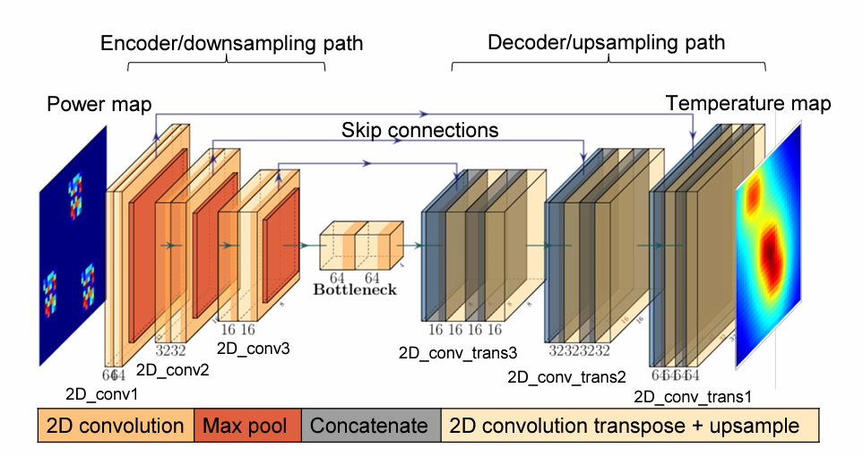
Use Case 1: IR Drop Prediction
OpenROAD Python Interpreter
Back-annotate results
Feature extraction
IR Drop Map
U-Net architecture
OpenDB database
V. Chhabria, et. al. ASP-DAC-21
Notes:
There has been a LOT of research in the past of using ML to predict IR drop, including an ICCAD Contest organized by ASU last year. Well if you think about how most of this reearhc is done. Folks use commercial EDA tool extract power per instance and instance locations into a file from the TCL interface. Then create power maps which they run through their trained ML model to get predicted IR drop values.
Next if these IR drop values had to be annotated back into the EDA tool, then it required another script in TCL to parse the file and annorate the numbers back in the commercial too.

Slide 40
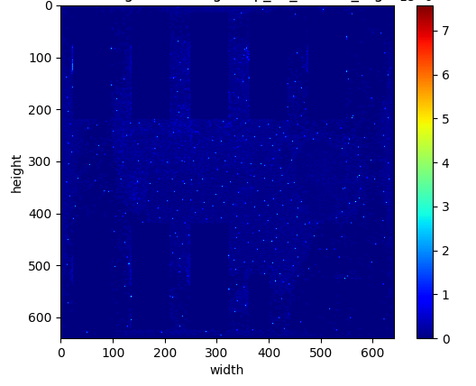
Use Case 1: IR Drop Prediction APIs
Location APIs
inst_x0 = inst.getBBox().xMin()
inst_y0 = inst.getBBox().yMin()
inst_x1 = inst.getBBox().xMax()
inst_y1 = inst.getBBox().yMax()
Power APIs
timing.staticPower(inst, corner)
timing.dynamicPower(inst, corner)
Notes:
However, now with our Python API, WITHIN a python shell we can query power numbers and location numbers directly return power maps from the EDA tool and also perform inference in the SAME python shell and back annotate the numbers into the database! Here are some example APIs that enable generation of these power maps highlighted here.

Slide 41
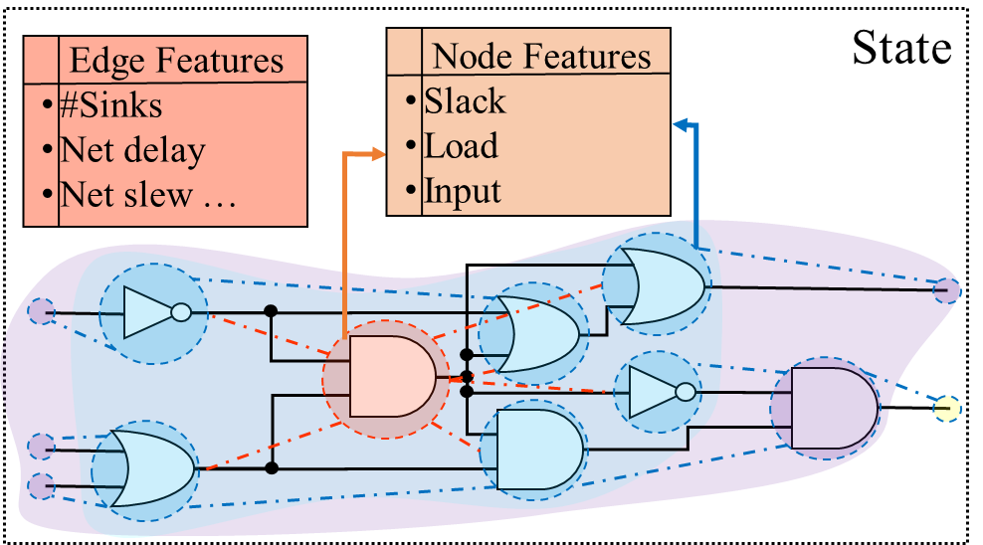
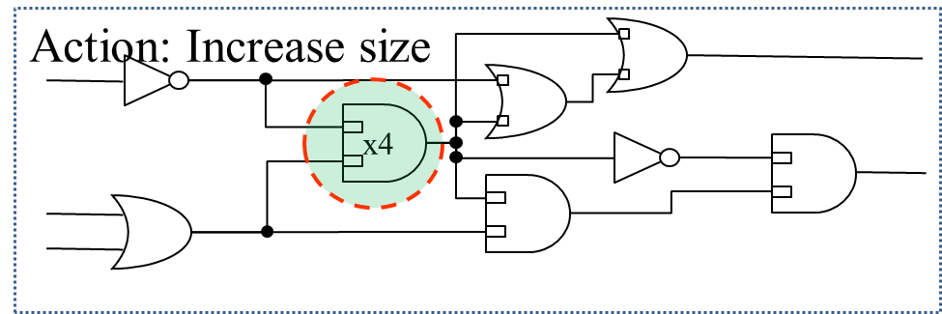
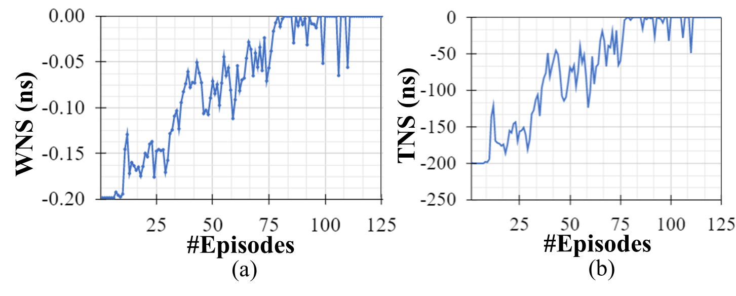
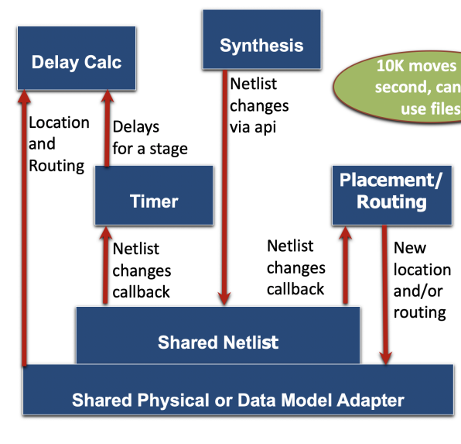
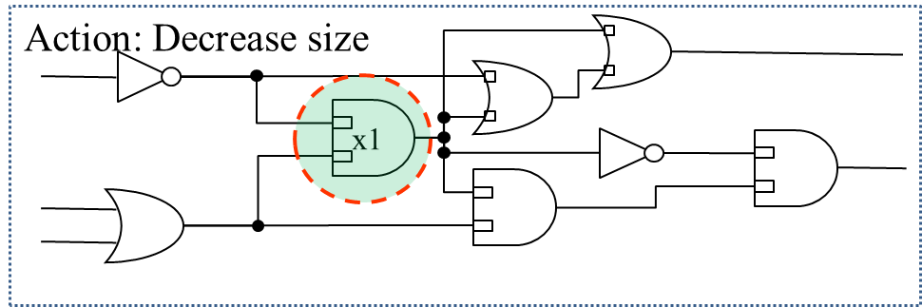
Use Case 2: RL-based Gate Sizing
State
Agent
Increase
Options
Reward
Action
Environment
Decrease
W. Jiang (UMN), V. Chhabria, S. Sapatnekar (UMN), 2023
Notes:
The next is a little more intricate use case. It shows an example of an Reinforcement learning based gate sizer. First let me explain the RL-based gate sizing problem. Let’s start off with a reulg RL problem. An agent decides what action to take in an environment based on current state of the environment. And action and reward pairs. It performs this loop iteratively until the agent is trained and the reward is maximized.
Now mapping that to a gate sizing problem …

Slide 42
Use Case 2: Supporting Python APIs
State example:
timing.getPinArrival(iTerm, Timing.Rise)
timing.getPinSlew(iTerm) timing.getNetCap(net, corner, Timing.Max)
timing.getNetCap(net, corner, Timing.Max)
odb.getNets()
odb.getNets().getITerms()
State
Agent
Increase
Action example:
inst.swapMaster (n_master)
Rewards example:
timing.getPinSlack(iTerm, Timing.Rise, Timing.Max)
Options
Reward
Action
Environment
Decrease
Notes:
Here are a few of the Python APIs that enable. For instance the state and its features
Reward estimation
Action

Slide 43
Use Case 2: RL-based Gate Sizing
Existing EDA Flows without Python Enablement
With OpenROAD Python Enablement
Need to reinvent the wheel
TCL Python wrapper
EDA developer environment (C++)
TCL wrapper
ML node and edge transformations; Transformation to API translators
EDA developer environment (C++)
TCL script
LEF/DEF data, netlist, RC
findInstance
swapMaster
updateTiming
LEF/DEF data, netlist, RC
TCL script
ML environment (e.g., RL gate sizing) (Python)
ML environment (e.g., RL gate sizing) (Python)
Slow file-based data transfer

Slide 44
Hands-ON Session
QuickStart: https://bit.ly/3SrE827 Please follow these instructions to prepare for your participation in the hands-on parts of today’s tutorial !
OpenROAD Python APIs

Slide 45
Agenda
1. Introduction (1400-1415, Andrew)
2. Tutorial Section 1
OpenROAD Python APIs (1415-1440, Vidya)
Hands-on session: Demo on OpenROAD Python APIs and what it enables (1440-1525, Bing-Yue)
BREAK (1525-1545 minutes)
3. Tutorial Section 2
CircuitOps (1545-1605, Vidya)
Hands-on session: Demo on CircuitOps and what it enables (1605-1635, Bing-Yue)
4. Other ML EDA Infrastructure Efforts + Conclusion (1635-1650, Andrew)
5. Overflow Q&A (1650- , Vidya and Bing-Yue)
Notes:
Thank you, Bing-Yue. Today we will conclude by pointing out other efforts that are also trying to build open infrastructure for ML EDA.
And Q&A can continue even after 5:00pm if there is interest.

Slide 46
3. Tutorial Section 2:
CircuitOps: ML-friendly data representation format
Notes:
Thanks everyone for gathering back from the break. Thanks Bing-Yue for the last hands-on session as well.

Slide 47
3.1 CircuitOps: The Why and What
Notes:
At NVIDIA a set of researchers from Mark Ren’s group published a paper at ICCAD 2023 on CircuitOps which is an ML-friendly data representation format or an ML Infrastructure Enabling Generative AI for VLSI Circuit Optimization.
The credit for the slide deck from here to the end of the talk goes to Rongjian Liang from NVIDIA

Slide 48

Motivation
AI-unfriendly data structures and interfaces of EDA tools, hindering high volumes of data queries, transfer and processing
Steep learning curve of EDA knowledge and tools for AI experts
Lack of shared IR (intermediate representation), hindering data reuse across projects
Unoptimized netlist
Optimized netlist
Barriers: Challenges in data query and processing for netlist optimization tasks
Liang et. al “CircuitOps: An ML Infrastructure Enabling Generative AI for VLSI Circuit Optimization,” ICCAD 2023.
Slide credits: Rongjian Liang, NVIDIA
Notes:
The motivation for CircuitOps is stems from three challenges:
First how EDA tool data structures are not ML-friendly. Requiring us to extract information of say timing at every pin in the design for timing optimization task requires us to loop through all the pins which limits parallelizability and high volumes of data transfer.
Second if we have to extract all the timing related features we need to know TCL and how EDA tools store these features in their database which does have a steep learning curve and can put off people who are new to the area particularly AI expoert who want to apply novel AI algorithms to their flows.
The third is this notion of a lack of a shared intermediate represention. So can we have a large AI-friendly database that can be useful to apply a verity of ML EDA algorithms for different tasks.
These three challenges have basically created barriers for us in applying say generative AI onto existing netlist for say a timing optimization task.

Slide 49
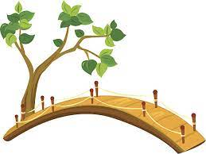
CircuitOps Contributions
Flexible and AI-friendly shared IR: reuse across tasks
Tool-agnostic IR format less EDA knowledge required for AI experts
Customizable data generation: support various tasks
Unoptimized netlist
Optimized netlist
Bridge: An infrastructure to facilitate data query and processing for netlist optimization
Liang et. al “CircuitOps: An ML Infrastructure Enabling Generative AI for VLSI Circuit Optimization,” ICCAD 2023.
Slide credits: Rongjian Liang, NVIDIA
Notes:
This is where CircuitOps comes in to lower that barrier and create a bridge.
It provides a data representation format that allows us to overcome those challenges earlier. The representation format called as an intermediate representation can store EDA data such that it can be reused across a variety of ML –EDA problems.
The second this is that the IR format itself is very easy for an AI expert to work with as they can query information from the format using EXISTING python APIs of standard python libraries such as DGL torch pandas graph-tool. They do not need to understand the complexities of EDA tool database write TCL or any of that.
The third is that the format can allow us to distill away properties that are non needed for a specific task and work with only those that are needed. This will make a littmore sense in our example.
The goal is for CiruictOPs to act as aen enabler for GenAI applications particularly those related to netlist optimization.

Slide 50
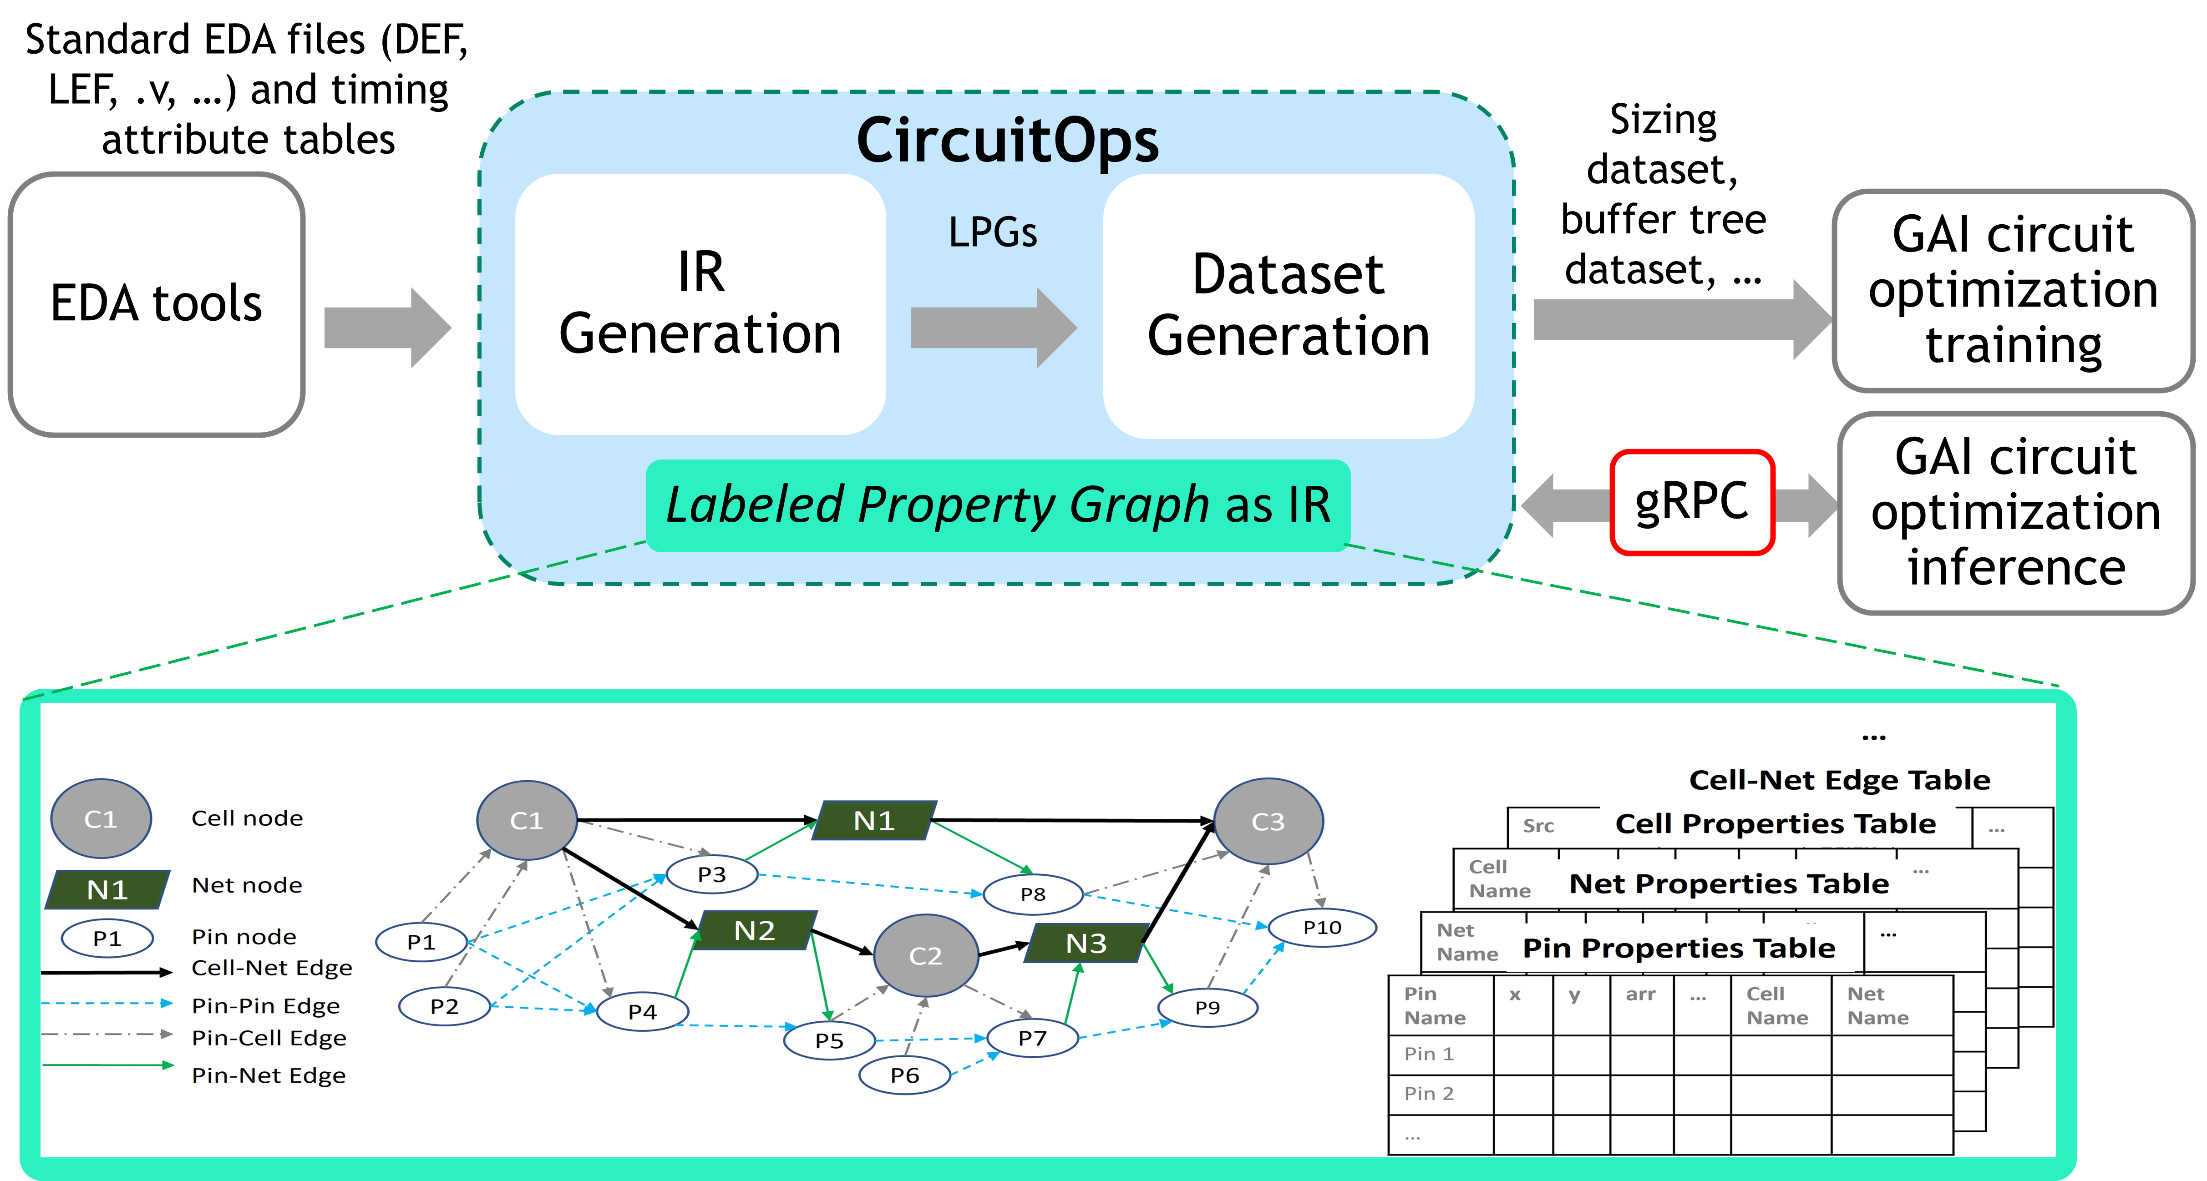
CircuitOps Overview
Liang et. al “CircuitOps: An ML Infrastructure Enabling Generative AI for VLSI Circuit Optimization,” ICCAD 2023.
Slide credits: Rongjian Liang, NVIDIA
Notes:
This is an overview of the CircuitOps LPG format. It consists of three stages here basically. The first is we need some sort of translators to convert existing EDA tool data into CircuitOps format. It could be direct parsers for LEF/DEF or it could scripts that work directly with EDA tool databased.
However, if all the EDA data was already represented in this format or once we invest in this one time cost it makes AI application much easier.
The second is dataset generation from the CircuitOps format and
the third is training these model.
There is also a fourth which we will not cover too much in this tutorial as is still needs development is inference that using remote procedure call (RPC) to enable inference or transfer of data between two servers as a call assuming ML inference happen on a GPU server and EDA data collection hasppen on a CPU server.

Slide 51
3.2 CircuitOps: Data Representation Format
Notes:
So lets move on to understanding this format.

Slide 52
Labelled Property Graph as Intermediate Representation
An LPG is a directed graph
Relational tables for feature representation
LPG is a conceptual data structure that can be instantiated using various Python libraries familiar to AI practitioners
End users can create filtered “views” of the LPG as needed
LPG provides a flexible and systematic way to store netlist information
Netlist
C1
C3
C2
Liang et. al “CircuitOps: An ML Infrastructure Enabling Generative AI for VLSI Circuit Optimization,” ICCAD 2023.
Slide credits: Rongjian Liang, NVIDIA
Notes:
The format uses this concept of an LPG or a labeled property graph which is backed by tables. So for netlist optimization task. It is a directed graph where every cell, pin or net is represented as a node. The connection between them as an edge. It’s sort of like a timing graph in traditional EDA.
The LPG can be instantiated using any Python graph package, DGL, graph tool etc. So this is common for AI practitoners to work with and eliminates the need to work with EDA tool databased. They can use existing DGL or graph tool APIs or pandas data frames to query the info.
Each node in the LPG is annotated with relations tables that store properties. We will see examples of these later. Each edge is also annotated with its tables and there are four kinds of edges. Edges that connect cell to net, pin to pin, pin to cell or pin to net. So overall we have seven such relational tables for each netlist.

Slide 53
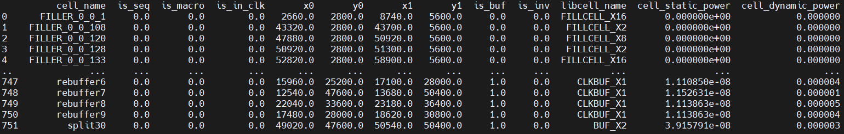
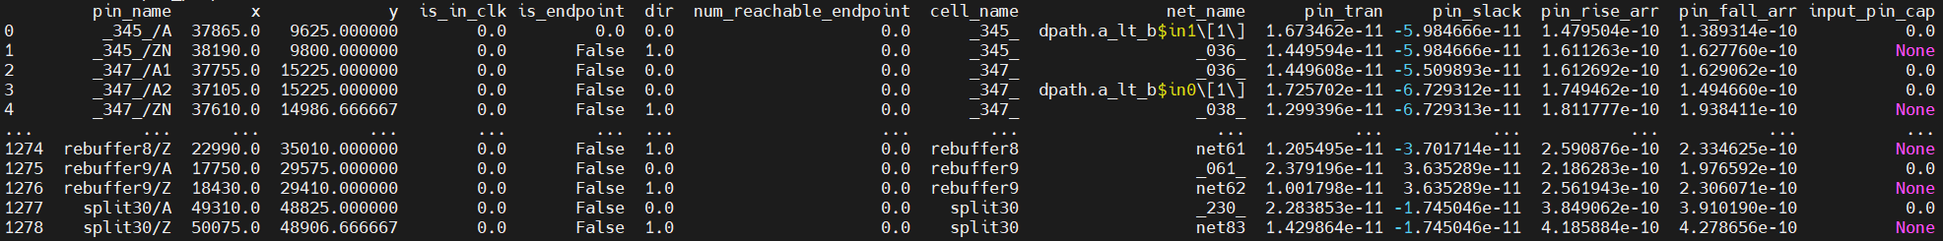

Example Relational Tables
Cell Properties Pandas Dataframes
coordinates
power attributes
Pin Properties Pandas Dataframes
coordinates
slew
slack
arrival times
Edge Properties Pandas Dataframes
Liang et. al “CircuitOps: An ML Infrastructure Enabling Generative AI for VLSI Circuit Optimization,” ICCAD 2023.
Notes:
Here are three example tables of the seven tables in CircuitOps. The cell properties, including locations of the cell some power attributes, pun proeprotes, including locations of the pins, some timing attributes on the pin. And edge propeorties, which include net cap, route length etc as examples.

Slide 54

Intermediate Representation Generation
OpenROAD Python APIs enable this flow for open-source community
Slide credits: Rongjian Liang, NVIDIA
Notes:
So, as I said the first step in this to create translators to represent data EDA tool data as these LPG + relational tables. One way to do it is to directly work LEF, DEF lib and build paraser over it to make it EDA tool agonotist. The other way is to directly work with EDA tool databases. Create the LLPG. The next step is go to datageneration. For this tutorial and the open-source version of CircuitOps we use the second techniques.

Slide 55

OpenROAD and CircuitOps: AI Dataset Generation
IR (LPG) generated by interacting with OpenDB
Dataset for task 1
AI Engine1
CircuitOps
…
…
Operating on AI and parallel-friendly LPG
Dataset for task i
AI Engine i
OpenROAD
…
…
Slide credits: Rongjian Liang, NVIDIA
Liang et. al “CircuitOps: An ML Infrastructure Enabling Generative AI for VLSI Circuit Optimization,” ICCAD 2023.
Notes:
Which is elaborated here. We use the Python APIs we talked about in the last section of the tuturoial from OpenROAD to directly generate the LPG and reltational tables. We then use the interemediate representation to generate data sets for different AI application perhaps or dififferent AI engines to process parallelly.

Slide 56
Dataset Generation Using CircuitOps
End user customize dataset generation script tailored to each GAI application
Act on AI- and parallel-friendly LPGs, allowing the utilization of existing graph-tool/ DGL/ igraph/ cugraph APIs for data processing.
Phase | Pattern | Exemplary function
Pre-processing | Node/edge filtering | Construct a filtered LPG with only pin nodes and pin-to-pin edges
 | Graph partitioning | Split the netlist at sequential cells
 | Graph traversal | Identify buffer trees
Feature extraction | Node/edge-based | Calculate HPWL for nets
 | Graph traversal | Compute the sum of reachable endpoint negative slacks
Sampling | Node/edge-based | Critical net sampling
 | Sub-graph-based | Buffer tree sampling
 | Path-based | Critical timing path sampling
Liang et. al “CircuitOps: An ML Infrastructure Enabling Generative AI for VLSI Circuit Optimization,” ICCAD 2023
Slide credits: Rongjian Liang, NVIDIA
Notes:
So coming to data generation, let us use gate sizing as an example. Now that we have al the EDA data represtned as LPG + relational tables. We can use EXISTING standard python libraries and APIs from graph tool or dgl to query the infroamtoin we need (features and labels) for dataset generation.
So for instance for the gate sizing problem, we first have to filter out certain notes and edges in the graph we do not ened and work only with pin nodes and pin to pin edges which are important for gate sizing. We can filter out notes using exiting graph tool APIs very easily.
Next we have to paroitioing the gaph. Basically split it at sequential cells. This can also be done very easily with Python APIs of graph tool. The third is we need to eliminate buffer trees as we may not want to size these cells. So we have to traverse the graph and find buffert trees. A simple bfs is a one line call with a graph tool API.
Next, we might need to extract certain features for gate sizing that are not already present in the relational tables. Say we want to use HPWL. We can calculate it on the fly from graph tool using again an existing python API library to do his very fast. We can also compute sum of reachable end point negative slacks through a single API graph traversal and node operations.
Ofcourse we can sample only simar parts of the LPG using traversals and sub graph APIs. But you can begin to understand that all of these will happen in existing Python APIs of these standard python libraries to make it easy for a non expert EDA user to work with EDA data.

Slide 57
3.3 CircuitOps: Enabled ML-EDA Algorithms
Notes:
So the next few slides I will talk a little bit about a dataset generation example using CircuitOps.

Slide 58

Use Case: Stage Delay Prediction Data Generation
Problem formulation:
Predict post-route stage delay at placement
Inputs features:
Driving strength of the driver cell
Sink capacitance
Distance between driver and the target sink
Context sink locations
A stage delay example:
from Pin c to Pin e
Assumptions:
Gate sizes are known
Routing and buffering are unknown
Slide credits: Rongjian Liang, NVIDIA
[1] Barboza, Erick Carvajal, et al. "Machine learning-based pre-routing timing prediction with reduced pessimism." DAC 2019.
Notes:
I am going to use stage delay prediction as an example. Stage delay is the delay from the input pin of the driver to the sink pins of the net the drieer connects to. This problem formulation here and the goal is to predict post-route stage delay at placement stage itself. The problem and the solution we adopted is from a script provided to us by Rongjian again, and this is based on a paper from Prof Jiang Hu’s group at Texas A&M.
The paper lists four features needed for this task. Drive strength, sink pin cap, distance between driver and target sink and sink location.
The label ofcoursee is the stage delay.

Slide 59
Use Case: Stage Delay Prediction Dataset Generation
Stage delay prediction dataset using CircuitOps
Load IR/LPG generated from post-route database
Construct a filtered LPG with only pin nodes and pin-to-pin edges
Utilize the “GraphView” functionality in graph-tool
Identify and remove buffer trees from the filtered LPG
These operations can be facilitated through “bfs search” functionality within graph-tool library
In the updated filtered LPG, extract input features and labels
Employing batch-processing operations on the (LPG node/edge) property tables stored in a Pandas DataFrame format
Dump out (input features, label) for all nets as numpy array for training
Slide credits: Rongjian Liang, NVIDIA
[1] Barboza, Erick Carvajal, et al. "Machine learning-based pre-routing timing prediction with reduced pessimism." DAC 2019.
Notes:
So lets see how CircuitOps can help with data generation for this task:
So we have all EDA tool data represented as IR/LPG+relational tables.. We now only need certain types of nodes. So we can created a filtered view of the graph using graph view.
Then maybe we do not want to size the buffer tree. So we perform a simple bfs using graph tool API and eliminate the buffer tree.
Then we need those four features. We can employ pandas data frames simple batch processing operations and get all the data at one shot instead of iterating through lets say pin in EDA tool to get the information. We now can directly dump out all the features and labels for training a numpy ararya or torch.
So to understand this better we will be going over the same example in the hands-on session.

Slide 60
Hands-On Session
QuickStart: https://bit.ly/3SrE827 Please follow these instructions to prepare for your participation in the hands-on parts of today’s tutorial !
CircuitOps: ML-friendly data representation

Slide 61
Agenda
1. Introduction (1400-1415, Andrew)
2. Tutorial Section 1
OpenROAD Python APIs (1415-1440, Vidya)
Hands-on session: Demo on OpenROAD Python APIs and what it enables (1440-1525, Bing-Yue)
BREAK (1525-1545 minutes)
3. Tutorial Section 2
CircuitOps (1545-1605, Vidya)
Hands-on session: Demo on CircuitOps and what it enables (1605-1635, Bing-Yue)
4. Other ML EDA Infrastructure Efforts + Conclusion (1635-1650, Andrew)
5. Overflow Q&A (1650- , Vidya and Bing-Yue)
Notes:
Thank you, Bing-Yue. Today we will conclude by pointing out other efforts that are also trying to build open infrastructure for ML EDA.
And Q&A can continue even after 5:00pm if there is interest.

Slide 62
4. ML EDA Infrastructure DEVELOPMENT EFFORTS WORLD-WIDE
Notes:
So …

Slide 63

4.1 Dataset Gathering Efforts
Synopsys APUP talk, Jan. 2022
Notes:
Data enables learning. But data for chips, or for EDA tools and flows, is difficult to collect and use for ML.
For example, tool documentation or reports cannot be publicly shared.
EDA and ML EDA research has many other blockers, including the ones shown on the right.
To help unblock ML EDA, there are a number of dataset gathering efforts.

Slide 64




BeGAN Power Grid Benchmarks
BeGAN PDN benchmark generation
Current map generation
Power grid synthesis
PDN templates
Power bumps
Trained GAN
OpeNPDN power grid synthesis
Current maps
Power grids
Satellite image
Jet scaled satellite image
GAN training
Source dataset
Pretrained GAN model
Urban satellite images
IP-protected GAN-generated benchmarks
TL
Target dataset
GAN benchmark generator
Real circuit data
Transfer learning-based training
SNGAN
[Chhabria, Kunal, Zabihi, Sapatnekar, ICCAD21]
Notes:
BeGAN is a project on dataset gathering for ML EDA applications from the University of Minnesota. Inspired by the success generative adversarial networks have in generating pictures of faces, this work uses GANs to generate synthetic power maps that resemble real circuit power maps.
However, due to the shortage of data, the real challenge is training these GANs to generate synthetic data itself. So, transfer learning is used, where the GAN is pretrained from urban satellite images which share similar characteristics as chip layout. The pretrained GAN weights are fine-tuned using a small amount of real circuit data. The trained GAN can generate images that have some similarities to real circuit power maps.

Slide 65









Power Grid Benchmarks and ICCAD Contest
[Chhabria, Kunal, Zabihi, Sapatnekar, ICCAD21]
https://github.com/UMN-EDA/BeGAN-benchmarks
https://github.com/ASU-VDA-Lab/ML-for-IR-drop
Notes:
Here are example images of the synthetic power maps that are available at the BeGAN repository. These images, along with power grid for each, also served as datasets for the ML for IR drop prediction contest at last November’s ICCAD – and you can find these benchmark data at the ML for IR drop repository shown here.

Slide 66
CircuitNet: Image-based dataset collection
https://github.com/circuitnet/CircuitNet
Chai, Zhuomin ; Zhao, Yuxiang ; Lin, Yibo ; Liu, Wei ; Wang, Runsheng ; Huang, Ru
“CircuitNet: An Open-Source Dataset for Machine Learning Applications in Electronic Design Automation (EDA)”
Notes:
CircuitNet is developed by Peking University.
It’s an open-source dataset dedicated to machine learning applications in EDA.
It supports four tasks: congestion prediction, DRC violation prediction, IR Drop prediction and Net Delay Prediction.
It includes 3 variations of datasets, CircuitNet-N28. CircuitNet-N14 and ISPD15.
CircuitNet-N28 is based on RISC-V designs and 28nm planar technology.
The gate-level netlists is also included in CircuitNet-N28.
CircuitNet-N14 is the advanced version of CircuitNet-N28. It includes more designs other than RISC-V, including GPU and ML accelerator, and based on 14nm FinFET technology.

Slide 67


IEEE CEDA DA Technical Committee (DATC)
IEEE CEDA DATC has developed open foundations for EDA researchers, notably the “RDF” (Robust Design Flow) since 2016
Prof. Chhabria is the new chair of the DATC – please contact her with ideas for projects and collaborations!
“METRICS2.1” standard naming of design metrics, along with python scripts to harvest from OpenROAD
“Calibrations” golden analysis data (timing, RCX, IR drop …) to improve academic research tools
https://github.com/ieee-ceda-datc/datc-rdf-Metrics4ML
https://github.com/ieee-ceda-datc/datc-rdf-calibrations
Notes:
The IEEE Council on Electronic Design Automation has a Design Automation Technical Committee that develops shared foundations for EDA research, including the “RDF” baseline tool flow which includes OpenROAD.
The DATC’s efforts include [CLICK] “METRICS” which proposes a standard naming for design metrics, and gives python scripts to harvest these from OpenROAD.
[CLICK] The “Calibrations” project creates public datasets for timing, parasitic extraction, and IR drop analyses, to help improve the accuracy of academic research codes.
Very important: [CLICK] Professor Chhabria is the new chair of the DATC, so if you have ideas for projects and collaborations, please discuss with her!

Slide 68
4.2 Data Representation Format Efforts
Notes:
There are also efforts to develop open data representations and formats.

Slide 69






EDA-schema
Property graph data-model schema incorporates circuit information
Structural data of the circuit
Performance metrics from reports
Netlist Graph
Circuit
Timing Path Graph
Physical design automation flow and corresponding netlist and circuit data formats
Interconnect Graph
Prof. Ioannis Savidis is338@drexel.edu EDA-schema:
Graph Datamodel Schema and Dataset for Design Automation
Notes:
EDA-schema from Professor Ioannis Savidis’s group at Drexel is a property graph data-model schema to represent digital circuits.
Netlists and performance reports are extracted out of the design tools after each stage of the design flow.
This allows extraction of structural information and performance metrics after each design phase.
Note that the post-routing netlists and performance metrics are the “final” data, but the earlier stages of the design flow also give useful structural information and estimated performance metrics. The numbers and metrics become more complete and accurate as the flow proceeds.
In EDA-schema, a circuit extracted from the design flow is represented as a graph, where nodes are IO pins, gates, and wires and edges are connections between them.
Additional graph representations like timing path graphs and interconnect graphs help complete the schema, and have also been developed by the Drexel team.

Slide 70

EDA-schema features
Property labelled graph handles graph and tabular data
Adaptors
Maps external data sources into EDA schema
Adaptors can be built for external applications to integrate it with EDA-schema
Conversely, adaptors can allow EDA-schema datastores to be projected into external environments
DB interfaces
Exports/imports EDA schema python object data into databases
Supports flatDB (csv for tabular and json for graph data) and mongoDB
Architecture supports easy extension to other dbs (graphQLs or RDBMS)
pytorch interface
Project EDA-schema data into pytorch objects used by EDA-ML for modelling tasks
Prof. Ioannis Savidis is338@drexel.edu EDA-schema:
Graph Datamodel Schema and Dataset for Design Automation
Notes:
EDA-schema is extensible and can be integrated with external tools.
This extensibility comes through DB interfaces and adaptors.
The schema currently interfaces with flatDB (exporting/importing circuit data into csvs and jsons) and mongoDB and can support other database formats as well.
A pytorch interface is being built to export the data into torch tensors.
Adaptors can be built to integrate EDA-schema as a submodule of external applications. Some recent discussions have been initiated on possible adaptors for CircuitOps, OpenAccess, OpenDB and something called the SPEED API which I’ll mention in a minute.

Slide 71

4.2 Software Infrastructure Development
https://sites.google.com/view/ml4eda/home
Notes:
Software infrastructure is also necessary. In fact, this was a significant aspect discussed in a workshop last year, sponsored by the U.S. National Science Foundation. The workshop report and materials are at the link shown.

Slide 72


SLICE: Shared Infrastructure for ML EDA
Prof. Jiang Hu, Texas A&M U. MLCAD 2023 invited talk
Notes:
This slide is from the main organizer of that workshop, Professor Jiang Hu of Texas A&M University – it’s actually from his invited talk at MLCAD last September.
The slide draws parallels between the AI/ML ecosystem’s open infrastructure – pretrained models, shared datasets, libraries, cloud scalability, contests that incentivize new ideas, foundation models, and so on.
A framework called SLICE was described – which envisions a similar infrastructure for ML EDA. This tutorial has demonstrated some of the pieces of this SLICE vision.
[CLICK] Then, there is a well-known concept of the “AI Flywheel”, which runs on the exhaust of data. Data that can be shared is really important. In this picture, more Users create more Data; more Data leads to better Models; better Models lead to better tools and Chips that bring more value and profits; and better Chips from ML EDA bring more Users.

Slide 73
Si2 Secure ProcEssEd Data (SPEED) API
Standard AI/ML shared infrastructure
API defines a standard for data access from CAD systems to ML frameworks
Easier training and inference implementations
Inference
Training
ML Framework
Standard API to move data from CAD/design system to ML Framworks
Design DB
Design features
Design Data
Thanks: Srinivas Bodapati, Intel Corp. and Si2 AI/ML in EDA SIG
Notes:
The Silicon Integration Initiative is a well-known consortium that hosts LEF/DEF, OpenAccess, Compact Modeling Coalition, and other initiatives, including a special interest group on AI/ML in EDA, and an interoperability-focused effort called TITAN. One aspect that Si2 members have been working on for some years is a “SPEED” API – a standard for data access from CAD systems to ML frameworks. You can think of OpenROAD plus CircuitOps as a proof of concept for such an API and how it might be used.

Slide 74
4.3 LLMs to Assist Chip Designers
Notes:
Last, we cannot spend three hours together without mentioning LLMs – large language models such as ChatGPT, which are just one area of generative AI.

Slide 75
ChatEDA: Conversational HCI
User
ChatEDA
EDA Tool
Prof. Bei Yu, Chinese University of Hong Kong, ICCAD 2023 Panel
arXiv: https://arxiv.org/pdf/2308.10204.pdf
Notes:
ChatEDA, from Professor Bei Yu’s team at the Chinese University of Hong Kong, was presented at MLCAD 2023 and there is a paper on arXiv. It is a conversational interface for human-to-toolflow interaction, and the paper presents five example tasks that have been validated with production of working OpenROAD Tcl scripts. The example here has the user requirement in natural language – implement AES using ASAP7 technology, with a floorplan utilization of 70%, and report a post-route power metric.
And if you think about it, you realize that the research involving ChatGPT4, and this paper itself, probably couldn’t have been done with a commercial SP&R tool like FusionCompiler.

Slide 76
ChatEDA: LLM dedicated to EDA
Based on a domain-specific LLM infused with EDA knowledge
Vertical task performance exceeds GPT-4
Prof. Bei Yu, Chinese University of Hong Kong, ICCAD 2023 Panel
arXiv: https://arxiv.org/pdf/2308.10204.pdf
Notes:
ChatEDA based on Llama2 can outperform GPT-4 after fine-tuning with domain knowledge – the arXiv paper has the details. We can expect many more works coming in the next year or two – and at least the academic papers will likely use an open platform like OpenROAD.

Slide 77

Conclusion
Before concluding, an advertisement for the MLCAD Symposium, September 9-11 in Snowbird, Utah
https://mlcad.org/symposium/
Notes:
Before concluding, let me give a quick plug for [CLICK] the MLCAD Symposium, this coming September in Utah.
It is a great meeting where many leading-edge results, such as the ChatEDA work I mentioned, are announced.
Vidya is one of the organizers this year – please consider attending, and I have some copies of the call for papers if you don’t have one already.

Slide 78
Conclusion
https://github.com/ASU-VDA-Lab/ASP-DAC24-Tutorial
There is an urgent need for ML EDA infrastructure to accelerate ML EDA research and innovation
This tutorial demonstrated:
OpenROAD Python APIs: Key enabling technology for ML frameworks and EDA tool interaction
CircuitOps: EDA data representation format for ML dataset generation
Challenge:
Scope for Python APIs is extensive and requires a community effort based on ML EDA usage
Notes:
In summary, we hope that you have seen the need and the possibilities for ML EDA infrastructure to accelerate progress in this area.
The tutorial showed OpenROAD’s Python APIs, and the CircuitOps format from NVIDIA – AND what is possible when you put OpenROAD and CircuitOps together. Please note that all of the tutorial materials, including these final slides, will be available in Professor Chhabria’s lab GitHub – the link is at the top of the slide.
There is a challenge for all of us as a community: to discover new ML EDA applications, and implement the additional APIs that enable these applications.
Last, all credit should go to Professor Chhabria and her student Bing-Yue for so much effort to create this tutorial. Let’s please thank them for all their hard work !

Slide 79
THANK YOU !
Questions?
abk@ucsd.edu , vachhabr@asu.edu , bingyuew@asu.edu
Notes:
Thank you and we can now have Q&A.

